Slide 1
Petrologia e Geodinamica
Laurea Magistrale in
Geologia di Esplorazione
Dipartimento di Scienze della Terra
Università degli Studi di Roma La Sapienza
Michele Lustrino
(michele.lustrino@uniroma1.it. Tel: 06 49914158. Stanza 114)

Slide 2
Part Four.
How and why mantle melts;
The role of volatiles in mantle melting;

Slide 3
Why a mantle melts
You should know how a solid mantle rock can partially melt.
Pressure decrease (passive upwelling at ridges; also in other settings where lithospheric plates diverge or get thin; this is called adiabatic decompression melting);
Addition of volatiles (H₂O and CO₂; mostly – but not exclusively - along subduction zones);
Increase of temperature (alleged Mantle Plumes; thermal anomalies. Laterally – e.g., along craton borders – or Vertically – in boundary layers; thermal equilibration of subducted slabs);
Change in chemical/mineralogical composition (chemical anomalies; everywhere).
We’ll see also that, when volatiles are present, it is possible to melt a rock by pushing it into the mantle!

Slide 4
Why a mantle melts
Temperature
Melting begins
Melt
P decrease
Solid +
Melt
T increase
Pressure
Melting begins
Melting begins
Addition of volatiles
Solid
Solidus
Liquidus

Slide 5
Let we introduce a fundamental argument in igneous petrology:
The shape of
mantle solidus
as function of its composition and volatile contents.

Slide 6
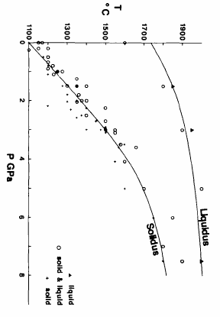
Experimental determinations of the solidus and liquidus of peridotite
The equation to obtain the pressure of the solidus as function of temperature is:
P (GPa) = (Ts-1100)/136 + 0.000497exp(0.012*(Ts-1100))
0
2
4
The equation to obtain the liquidus temperature as function of pressure is:
T (°C) = 1736.2 + 0.4343*P + 180*arctan(P/2.2169)
6
Solid
8
Solid + Liquid
McKenzie and Bickle, 1988 (J. Petrol., 29, 625-679)
Liquid

Slide 7
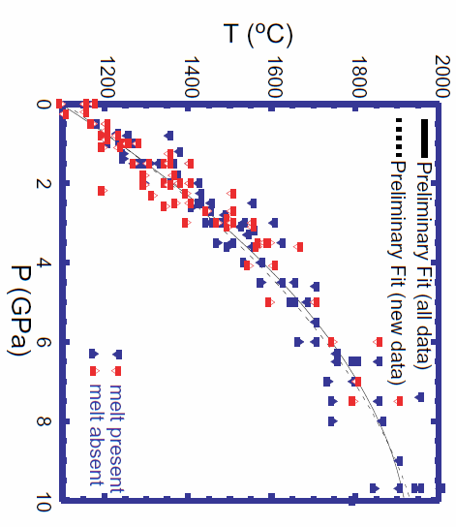
Experimental determinations of the solidus and liquidus of peridotite
Blue symbols =
pre-1988 data (from McKenzie and Bickle, 1988).
Red Symbols =
1988-2000 data.
Hirschmann, 2000 (Geochem. Geophys. Geosyst., 2000GC000070)

Slide 8
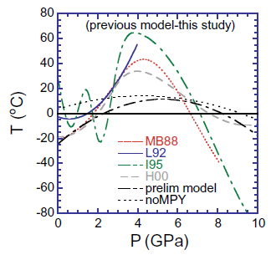
Experimental determinations of the solidus and liquidus of peridotite
Comparison of the recommended dry peridotite solidus of Hirschmann (2000) relative to selected other model solidi from the literature.
Note: this and the previously shown mantle solidus corresponds ONLY to volatile-free assemblages, excluding Enriched and Depleted compositions.
Hirschmann, 2000 (Geochem. Geophys. Geosyst., 2000GC000070)

Slide 9
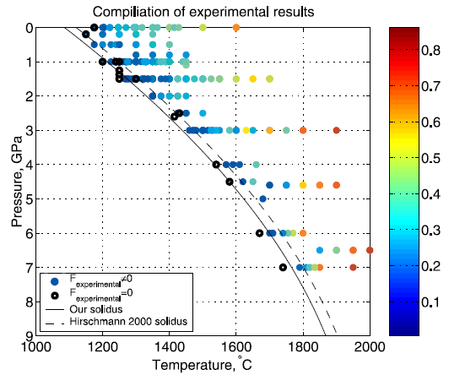
Experimental determinations of the solidus and liquidus of peridotite
Another proposed solidus for volatile-free mantle.
New anhydrous mantle solidus
Herzberg and Asimow, 2015 (Geochem. Geophys. Geosyst., 16, 563-578)
No substantial differences.
Katz et al., 2003 (Geochem. Geophys. Geosyst. doi:10.1029/2002GC000433)

Slide 10
Experimental determinations of the solidus and liquidus of peridotite
Another proposed solidus for volatile-free mantle.
~40 °C difference
New anhydrous mantle solidus
Katz et al. (2005)
Herzberg and Asimow, 2015 (Geochem. Geophys. Geosyst., 16, 563-578)
Hirschmann (2000)
McKenzie and Bickle (1988)
~130 °C difference
No substantial differences.
Katz et al., 2003 (Geochem. Geophys. Geosyst. doi:10.1029/2002GC000433)

Slide 11
Top 800 km of pyrolitic mantle hypothetical mineral assemblage.
Temperature (°C)
1400
1600
1800
2000
2200
2400
2600
0
100
Liquid
5
200
Ol + Opx +
Cpx + Gt
10
300
α
γ Olivine (Mg₂SiO₄) = Mg-Perovskite (MgSiO₃) + Mg-Wustite MgO
β
15
b + Cpx +Gt
Depth (km)
Pressure (GPa)
β
b + Gt
γ
20
Gt + γ + CaPv
Bridgmanite
600
670
(2014)
Gt + MgPv + Mw + CaPv
25
700
Mg-Wustite (Mg,Fe)O =
Fe-Periclase (Fe,Mg)O
Mw + MgPv + CaPv
30
800
Herzberg and Zhang, 1996 (J Geophys. Res., 101, 8271-8295)

Slide 12
Top 800 km of pyrolitic mantle hypothetical mineral assemblage.
Temperature (°C)
1400
1600
1800
2000
2200
2400
2600
0
100
Liquid
5
200
Ol + Opx +
Cpx + Gt
10
300
α
β
15
b + Cpx +Gt
Depth (km)
The 660-670 km seismic discontinuity is extremely important for mantle dynamics. It separates upper from lower mantle.
Pressure (GPa)
β
b + Gt
γ
20
Gt + γ + CaPv
600
670
25
Gt + MgPv + Mw + CaPv
700
Mw + MgPv + CaPv
30
800
Herzberg and Zhang, 1996 (J Geophys. Res., 101, 8271-8295)
Notes:
12

Slide 13
Question:
Do you know what a PYROLITE is?
Pyrolite is a theoretical rock considered to be the best approximation of the composition of Earth’s upper mantle.
It is generally considered as being 1 part tholeiitic basalt and 3 parts peridotite residuum (harzburgite or dunite).
There are at least three types of pyrolites (Tinaquillo Pyrolite, MORB Pyrolite and Hawaiian Pyrolite) used as starting material in experimental petrology studies.

Slide 14
Question:
Do you know what a PYROLITE is?
Pyrolite is a theoretical rock considered to be the best approximation of the composition of Earth’s upper mantle.
It is not possible to have a 10x10 cm rock sample of a Pyrolite. You will never find it in a rock collection.
It represents an average hypothetical composition.
Notes:
14

Slide 15
Experimental determinations of the solidus hypothetical pyrolite
Temperature (°C)
Volatile-free Pyrolite solidi for different compositions.
1000
1100
1200
1300
1400
1500
1600
1700
Tinaquillo Pyrolite
Pl-Lherz
1
MORB Pyrolite
Sp-Lherz
Hawaiian Pyrolite
The three types of pyrolite differ essentially for the (Na+K)/Ca ratio.
2
Pressure (GPa)
~100 °C difference
Gt-Lherz
3
What is the more fertile pyrolite composition?
4
Litasov, 2011 (Russ. Geol. Geophys., 52, 475-492)

Slide 16
Down to the 660-670 km seismic discontinuity, the subducted slab (eclogite) has nearly the same density of ambient mantle or is even denser.
At P >670 km the mantle assemblage becomes much denser and a density crossover verifies. Under these conditions the slab cannot penetrate more and probably it folds and stagnate.
Temperature (°C)
1400
1600
1800
2000
2200
2400
2600
0
Previous T-P field
100
Liquid
5
200
Ol + Opx +
Cpx + Gt
10
300
α
β
15
b + Cpx +Gt
Depth (km)
Pressure (GPa)
β
b + Gt
γ
20
Gt + γ + CaPv
600
670
25
Gt + MgPv + Mw + CaPv
700
Mw + MgPv + CaPv
30
800

Slide 17
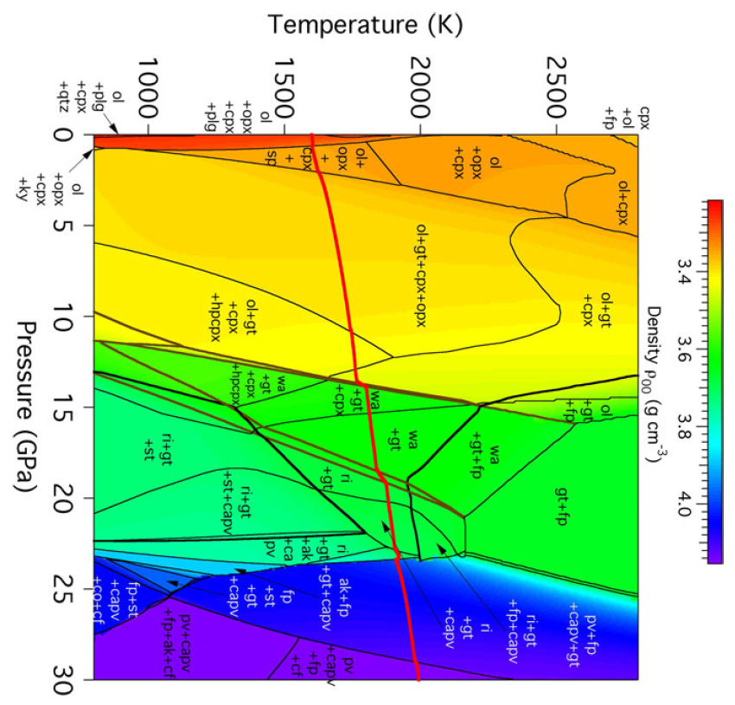
Since the mantle assemblage deeper than 670 km is denser than the shallower assemblage, a full convecting system is considered improbable.
This means that probably Earth’s mantle is characterized by two different convecting systems whose boundary is the 660-670 km discontinuity.
Stixrude and Lithgow-Bertelloni, 2011 (Geophys. J. Int., 184, 1180-1213)

Slide 18
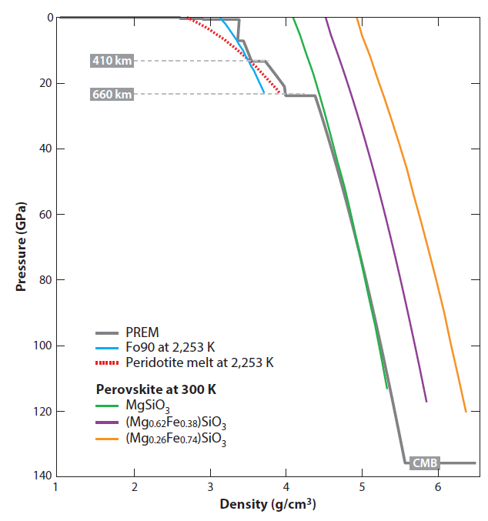
Since the mantle assemblage deeper than 670 km is denser than the shallower assemblage, a full convecting system is considered improbable.
This means that probably Earth’s mantle is characterized by two different convecting systems whose boundary is the 660-670 km discontinuity.
Large density difference between upper (<410 km) and lower (>660 km) mantle
PREM
Preliminary Earth Reference Model
(Diezwonski and Anderson, 1981)
Carlson et al, 2014 (Annu. Rev. Earth Planet. Sci., 42, 151-178)
~3.5
~4.4

Slide 19
Note that the folded and stagnating subducted slab (eclogite) is characterized by a solidus temperature several degrees (up to 400 °C) lower than ambient mantle.
This means that this region of the mantle is prone to easy and abundant melting.
Often this has been considered the source region for several CiMACI rocks.
CiMACI Province:
Circum-
Mediterranean
Anorogenic
Cenozoic
Igneous
Province
Temperature (°C)
1400
1600
1800
2000
2200
2400
2600
0
100
Liquid
5
200
10
Ol + Cpx + Gt
300
a
b
15
b + Cpx +Gt
Depth (km)
Pressure (Gpa)
b
b + Gt
g
20
Gt + g + CaPv
600
670
25
Gt + MgPv + Mw + CaPv
700
Mw + MgPv + CaPv
30
800

Slide 20
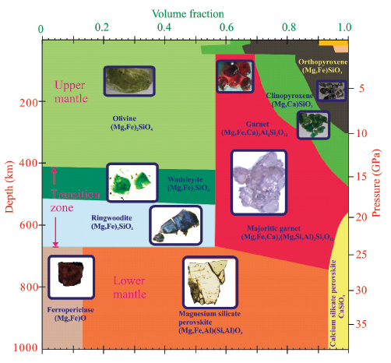
Mineral volume fractions for the top 1000 km of a pyrolite mantle.
Small orange and pink regions in the top right-hand corner denote the stabilities of feldspar and spinel, respectively.
Frost, 2008 (Elements, 4, 171-176)

Slide 21
Mineral volume fractions for the top 1000 km of a pyrolite mantle.
Do you know the peculiarity of the majoritic garnet?
Two atoms of Al³⁺ are substituted by (Si⁴⁺ + Mg²⁺).
I.e., pyrope increases the enstatite content in its formula.
Frost, 2008 (Elements, 4, 171-176)

Slide 22
0
Assuming this volatile-free solidus and this Geotherm, can we have partial melting in the upper mantle?
Volatile-free
Solidus
Hypothetical
Geotherm
100
200
Depth (km)
300
No, of course…
400
500
1000
1500
Temperature (°C)
Wyllie and Riabchikov, 2000 (J. Petrol., 41, 1195-1206)

Slide 23
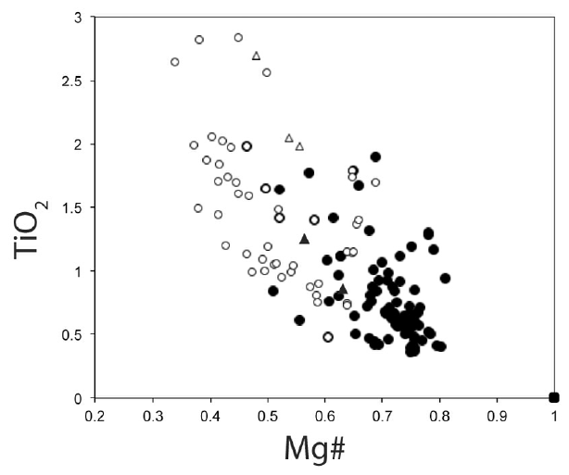
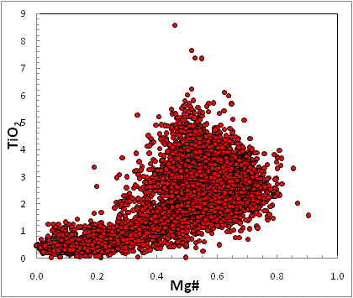
Derivative liquids (melts formed after fractional crystallization)
No experimental melts produced with these compositions.
?
?
Composition of the experimental liquids in equilibrium with a plagioclase (white circles and triangles) or spinel lherzolite
(black circles and triangles) phase assemblage (olivine + cpx + opx plag spinel).
Tilley et al., 2012 (J. Geophys. Res., B06206, doi:10.1029/2011JB009044)
CiMACI rocks. Database from Lustrino and Wilson (2007) Earth-Sci. Rev., 81, 1-65
Volatile-free experimental partial melts of various types of peridotites cannot explain the TiO₂ content of many “anorogenic” melts.

Slide 24
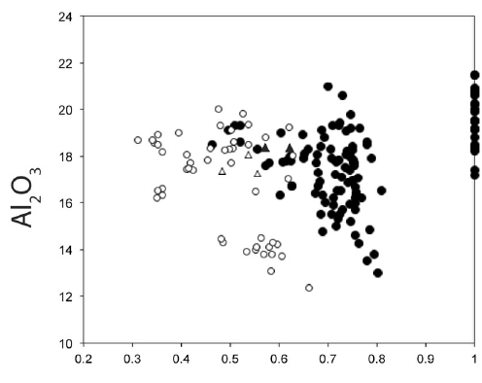
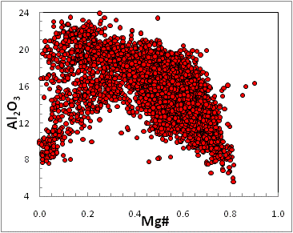
?
Mg#
Composition of the experimental liquids in equilibrium with a plagioclase (white circles and triangles) or spinel lherzolite
(black circles and triangles) phase assemblage (olivine + cpx + opx plag spinel).
Tilley et al., 2012 (J. Geophys. Res., B06206, doi:10.1029/2011JB009044)
CiMACI rocks. Database from Lustrino and Wilson (2007) Earth-Sci. Rev., 81, 1-65
Volatile-free experimental partial melts of various types of peridotites cannot explain the Al₂O₃ content of many “anorogenic” melts.

Slide 25
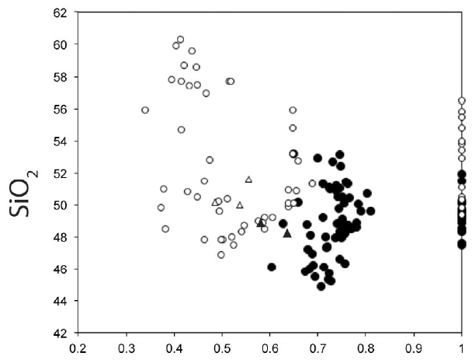
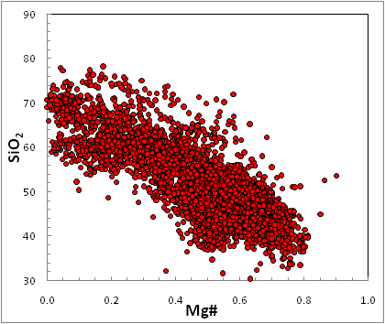
?
SiO₂ content of basaltic magma
Mg#
Composition of the experimental liquids in equilibrium with a plagioclase (white circles and triangles) or spinel lherzolite
(black circles and triangles) phase assemblage (olivine + cpx + opx plag spinel).
Tilley et al., 2012 (J. Geophys. Res., B06206, doi:10.1029/2011JB009044)
CiMACI rocks. Database from Lustrino and Wilson (2007) Earth-Sci. Rev., 81, 1-65
Volatile-free experimental partial melts of various types of peridotites cannot explain the SiO₂ content of many “anorogenic” melts.

Slide 26
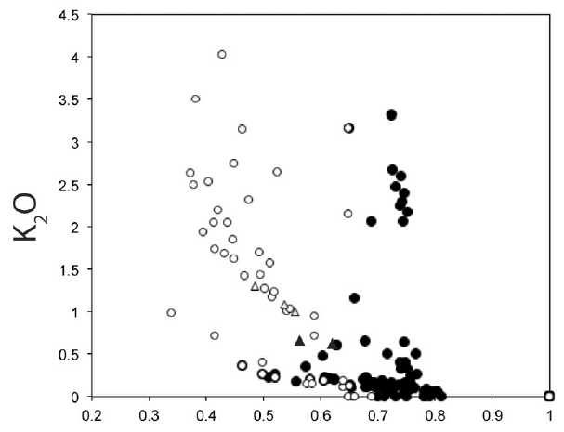
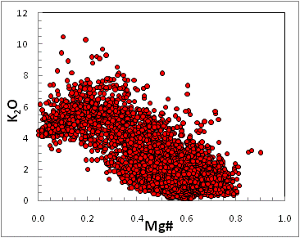
?
Mg#
Composition of the experimental liquids in equilibrium with a plagioclase (white circles and triangles) or spinel lherzolite
(black circles and triangles) phase assemblage (olivine + cpx + opx plag spinel).
Tilley et al., 2012 (J. Geophys. Res., B06206, doi:10.1029/2011JB009044)
CiMACI rocks. Database from Lustrino and Wilson (2007) Earth-Sci. Rev., 81, 1-65
Volatile-free experimental partial melts of various types of peridotites cannot explain the K₂O content of many “anorogenic” melts.

Slide 27
In other words:
Partial melting of anhydrous four-phase peridotite cannot produce liquids matching the composition of “anorogenic” magmas.
Experimental four-phase peridotite partial melts are too rich in SiO₂ and Al₂O₃ and are too poor in TiO₂ and K₂O compared with natural partial melts generated in within-plate tectonic settings.
Some other phase must be involved in the genesis of this kind of magmas.

Slide 28
In other words:
Partial melting of anhydrous four-phase peridotite cannot produce liquids matching the composition of “anorogenic” magmas.
We will see that additional phases involved in the genesis of primitive melts are hydrous silicates (amphibole and mica) plus carbonates (dolomite and magnesite).
This means that Earth’s mantle is C-H-bearing, not volatile-free, as usually assumed by geophysicists (and many geochemists too).

Slide 29
The role of volatiles
Volatiles such as hydrogen, carbon, sulfur, and halogens stored at depths in various forms and concentrations, are known to have significant effect on the generation of partial melts.
Extraction or impregnation of partial melts in turn can deplete or enrich the mantle in volatiles and cause compositional changes in major and trace elements.
The presence of volatiles and melts are also known to influence the rheology and seismic properties of minerals, and likely have considerable influence on convective processes in the mantle.
Dasgupta and Dixon, 2009 (Chem. Geol.262, 1-3)

Slide 30
The role of volatiles
Hydrogen can be dissolved in minimum amounts in the main silicates (ol, cpx and opx) and in relatively high amounts (2-3 wt%) in other silicates (phlogopite, pargasite) or even more (up to 15 wt% in serpentine, talc, chlorite and dense hydrous silicate minerals).
Water can be found also in minerals stable in the subducted slabs (e.g., lawsonite, phengite, epidote, chloritoid); max H₂O up to 11 wt%.
Water can be present in the mantle also in hydrous fluids and concentrated in melts.

Slide 31
The role of volatiles
On the other hand, Carbon is insoluble (absolutely incompatible; KD ~0) in the silicates and can be found in different states as function of fO₂ (e.g., graphite, diamond, magnesite, dolomite, CO₂, CH₄, Fe₃C, Fe₇C₃).
The solubility of CO₂ in melts increases strongly with pressure.

Slide 32
The role of volatiles
Recent results indicate that clinopyroxene can host up to 1400 ppm (0.14 wt%) of H₂O, garnet up to 260 ppm (0.03 wt%) and olivine up to 400 ppm (0.04 wt%).
At higher pressures (12 GPa ~410 km) olivine (wadsleyite) can host up to 0.6 wt.% H₂O.
H₂O content of forsterite as function of Pressure
Experiments only with H
In comparison, olivine can host only 12 ppm (0.001 wt%) C at 12 GPa.
Experiments with C and H
Litasov et al., 2009 (Rus. Geol. Geophys. 50, 1129-1138

Slide 33
The role of volatiles
Recent results indicate that clinopyroxene can host up to 1400 ppm (0.14 wt%) of H₂O, garnet up to 260 ppm (0.03 wt%) and olivine up to 400 ppm (0.04 wt%).
At ~1300 °C olivine can host up to 0.9 wt.% H₂O.
Experiments only with H
H₂O content of forsterite as function of Temperature
At lower T, Wadsleyite and Ringwoodite (high-P polymorph of olivine) can host up to 2-3 wt% H₂O.
Experiments with C and H
Litasov et al., 2009 (Rus. Geol. Geophys. 50, 1129-1138

Slide 34
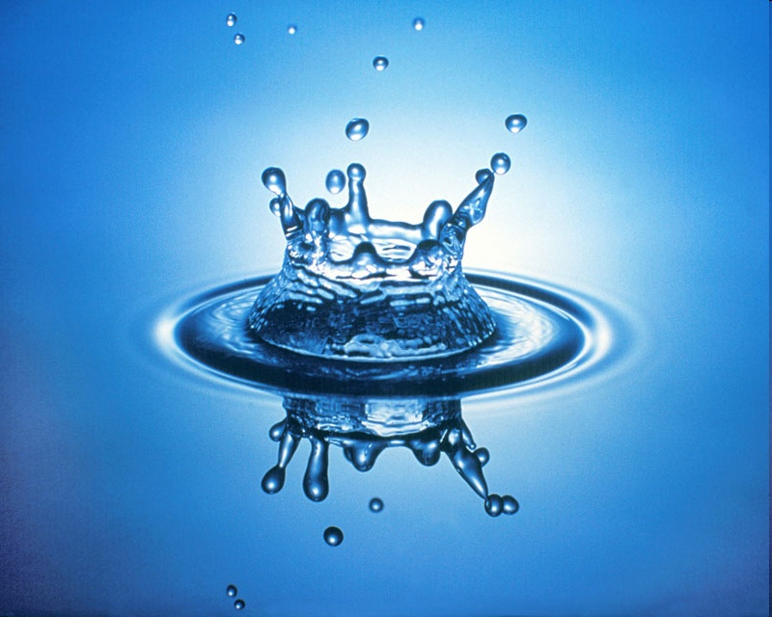
The role of volatiles
Recent results indicate that clinopyroxene can host up to 1400 ppm (0.14 wt%) of H₂O, garnet up to 260 ppm (0.03 wt%) and olivine up to 400 ppm (0.04 wt%).
Strictly speaking, the substance in the Earth’s mantle is not “water” but hydroxyl ion OH⁻.

Slide 35
The role of volatiles
The distribution, the inventory and the mechanisms of transport of H₂O in the mantle reservoirs remains uncertain.
Estimates of the total amount of H₂O stored in Earth’s mantle range from ~0.2 to ~4 times the ocean masses.
The presence of H₂O has strong effects on the convective flow in the Earth’s interior and, obviously on concentration of partial melts.
Hirschmann, 2006 (Annu. Rev. Earth Planet. Sci. Lett., 34, 629-653)

Slide 36
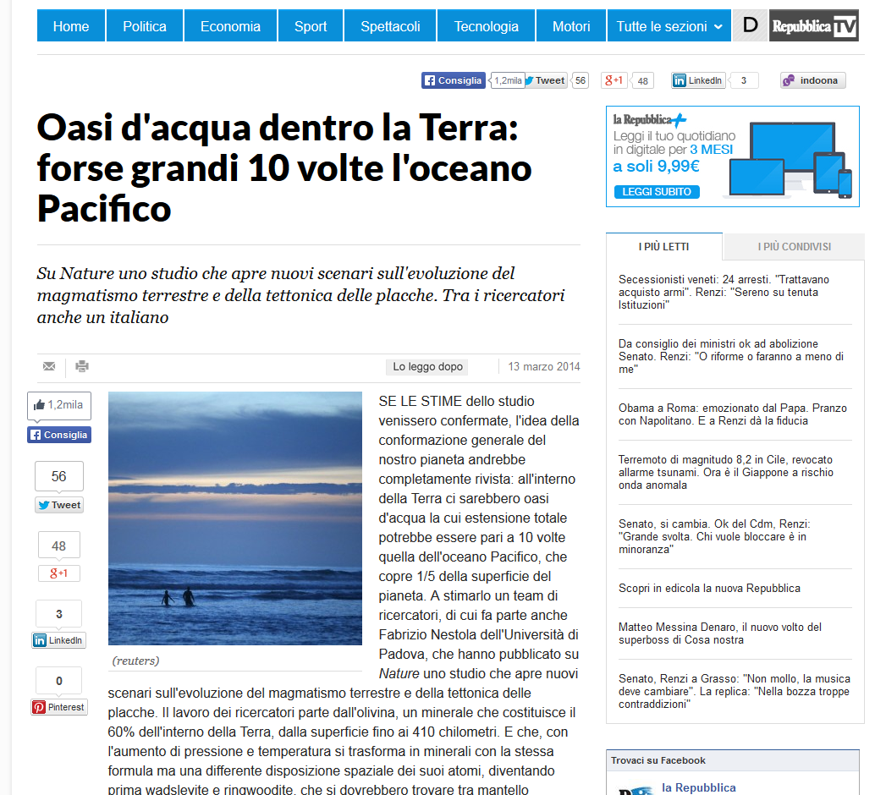

Slide 37
The role of volatiles
a = Mantle wedge
b = OIB source
c = MORB source
d = Pervasive melting above the 410 km discontinuity
e = Localized upwelling above the 410 km discontinuity
f = Downwelling below the 670 km discontinuity
Possible regions of hydrous melting in the mantle.
Hirschmann, 2006 (Annu. Rev. Earth Planet. Sci. Lett., 34, 629-653)
Notes:
37

Slide 38
Do you remember this scheme?
P decrease
Temperature
Melting begins
Melt
T increase
Solid +
Melt
Addition of volatiles
Pressure
Melting begins
Melting begins
P INCREASE
Solid
Solidus
Liquidus
Notes:
38

Slide 39
Do you remember this scheme?
Did you understand why and how a mantle may be forced to melt with pressure increase?
P decrease
T increase
Addition of volatiles
P INCREASE
Hirschmann, 2006 (Annu. Rev. Earth Planet. Sci. Lett., 34, 629-653)
Lower mantle minerals (bridgmanite and Mg-Wustite) have very low H₂O storage capacity. The H₂O stored in wadsleyite cannot be stored in lower mantle minerals and therefore it is expelled and H₂O-oversaturation occurs.
Notes:
39

Slide 40
Do you remember this scheme?
Did you understand why and how a mantle may be forced to melt with pressure increase?
P decrease
T increase
Addition of volatiles
P INCREASE
Hirschmann, 2006 (Annu. Rev. Earth Planet. Sci. Lett., 34, 629-653)
The Lower Mantle can be likely considered a Desert into the mantle.
Notes:
40

Slide 41
Do you remember this scheme?
Note another very interesting feature:
What is the fate of the melts produced above the 410 km and below the 670 km discontinuities?
These hydrous melts may be negatively buoyant (denser than ambient mantle).
Consequentially, they may percolate downward in the Transition Zone or down to the CMBL (D”).
Hirschmann, 2006 (Annu. Rev. Earth Planet. Sci. Lett., 34, 629-653)
It is not yet clear what is the density contrast of hydrous melts and mantle rocks at these depths.
Notes:
41

Slide 42

Do you remember this scheme?
The Transition Zone is effectively a Sponge
It has been speculated that the volume of H₂O stored in this small volume rivals that of the oceans.
Hirschmann, 2006 (Annu. Rev. Earth Planet. Sci. Lett., 34, 629-653)
Notes:
42

Slide 43
The role of volatiles
H₂O behaves incompatibly during mantle melting and subsequent shallow differentiation processes.
Olivine
Orthopyroxene
Clinopyroxene
Garnet
Hirschmann, 2006 (Annu. Rev. Earth Planet. Sci. Lett., 34, 629-653)
Notes:
43

Slide 44
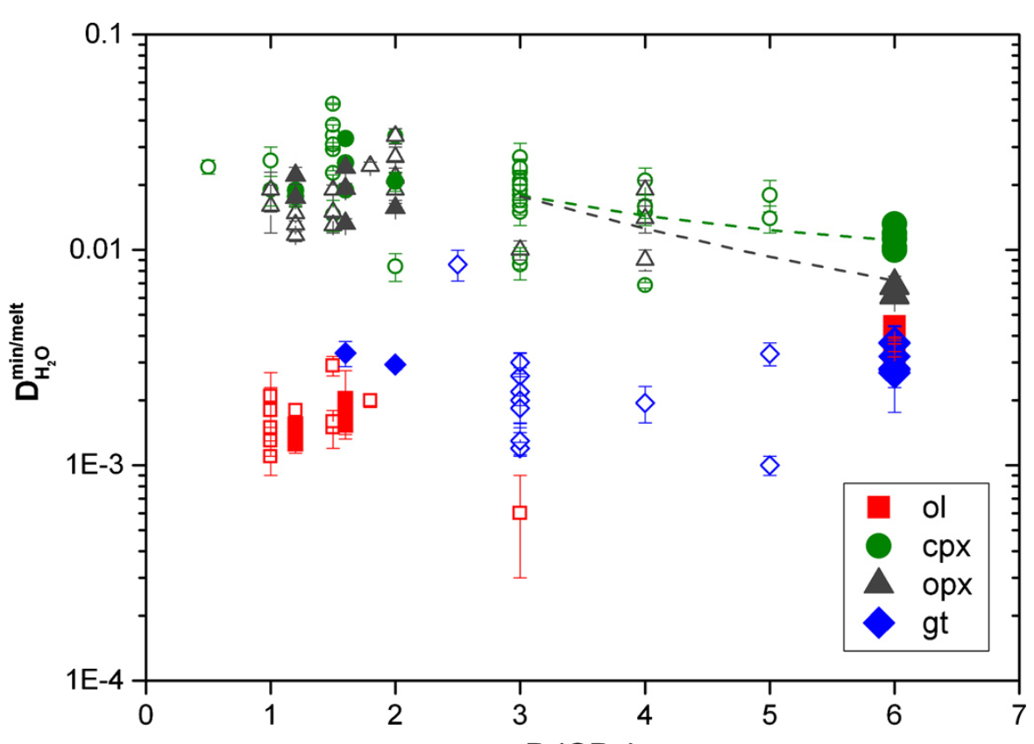
The role of volatiles
H₂O behaves incompatibly during mantle melting and subsequent shallow differentiation processes.
Kd
H₂O
Ol
Average Bulk distribution coefficient (D) of H₂O in peridotite
Novella et al.,2014 (Earth Planet. Sci. Lett., 400, 1-13)
Notes:
44

Slide 45
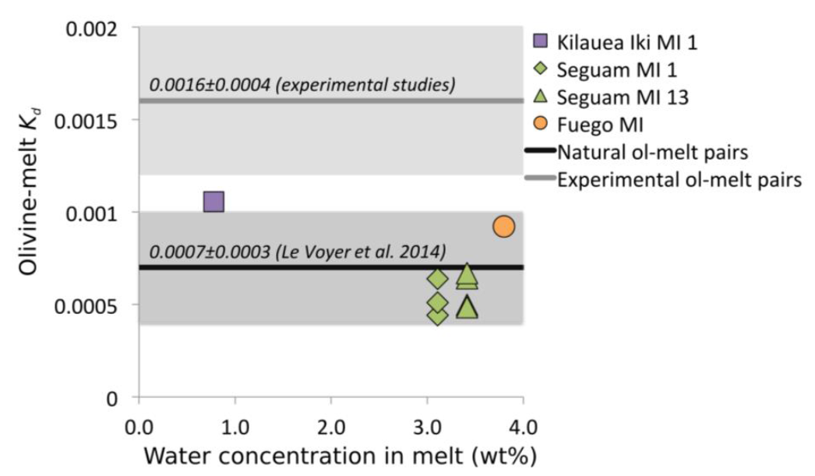
The role of volatiles
H₂O behaves incompatibly during mantle melting and subsequent shallow differentiation processes.
(Previous slide Kd^{H2O}_{Ol} range)
Measured Kd describing the equilibrium distribution of water between olivine and silicate melt.
Kd values determined from high-pressure experiments are higher on average than Kd values determined by measurement of water in olivine-melt inclusion pairs.
Liquidus olivine have lower Kd due to lower P of equilibration.
Newcombe et al., 2020 (J. Volcanol. Geotherm. Res., 398, 106872)
Notes:
45

Slide 46
The role of volatiles
H₂O behaves incompatibly during mantle melting and subsequent shallow differentiation processes.
D_{H2O} is very low, showing greatest similarity to LREE (e.g., Ce).
^{Peridotite}
^{Peridotite}
D_{H2O} ~0.007-0.009
Using the classical equation of Shaw, it is possible to infer:
The amount of H₂O in near-solidus melt (assuming a given amount in the source) and/or
The amount of H₂O in the source (assuming a given amount of H₂O in partial melts).
Notes:
46

Slide 47
The role of volatiles
The partition coefficient of hydrogen between minerals and melts is low (<0.05).
This implies that, assuming a MORB mantle with bulk H₂O content of 50-200 ppm, near-solidus partial melts beneath oceanic ridges can have H₂O content ranging from 0.5 to 3.3 wt%.
C_{L} = C₀/[D+F(1-P)]
Bulk Partition coefficient of the phases entering the melt.
Concentration of a trace element in a liquid.
Bulk Partition coefficient in the source.
Concentration of the same element in the source.
Molar fraction of melt produced.
Notes:
47

Slide 48
The role of volatiles
The partition coefficient of hydrogen between minerals and melts is low (<0.05).
This implies that, assuming a MORB mantle with bulk H₂O content of 50-200 ppm, near-solidus partial melts beneath oceanic ridges can have H₂O content ranging from 0.5 to 3.3 wt%.
C_{L} = C₀/[D+F(1-P)]
0.005-0.01
Minerals entering the melt
0.005-0.02 wt%
50-200 ppm
0.005-0.01
0.001
Minerals in the starting assemblage
F = 0.1%

Slide 49
The role of volatiles
Similarly, assuming a mantle with bulk H₂O content of 300-1000 ppm, near-solidus partial melts of oceanic islands (OIB) can have H₂O content ranging from ~3 to ~17 wt%.
0.005-0.01
C_{L} = C₀/[D+F(1-P)]
Minerals entering the melt
0.03-0.1 wt%
300-1000 ppm
0.005-0.01
0.001
Minerals in the starting assemblage
F= 0.1%
Of course, increasing the degree of melting will result in a dilution of the amount of hydrogen in the melt
(e.g., with F = 1% C_{L} = ~2-7 wt%).

Slide 50
The role of volatiles
Similarly, assuming a mantle with bulk H₂O content of 300-1000 ppm, near-solidus partial melts of oceanic islands (OIB) can have H₂O content ranging from ~3 to ~17 wt%.
Recent studies indicate much higher H₂O amount in OIB-like magmas in NE China (up to 2860 ppm).
Can these sources be modelled as volatile-free by seismologists?
Certainly not.
The origin of this water-rich mantle is related to the Big Mantle Wedge Model and the subducting Pacific slab who can provide hydrous upwelling for a very long time period.
Liu et al., 2020 (Lithos, 352-353, 105249)

Slide 51
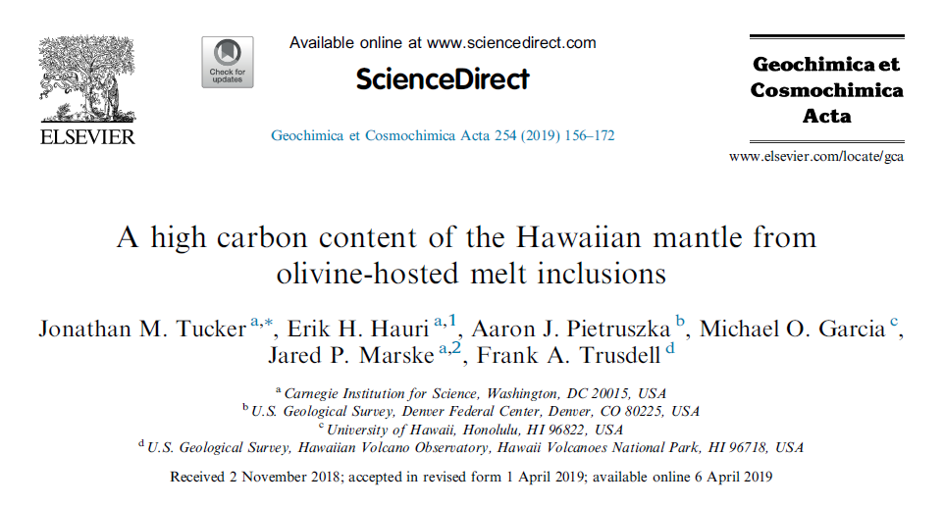
The role of volatiles
Earth's mantle contains very small amount of CO₂ in the range from 50 to ~500 ppm.
Other estimates range from 20-30 ppm (MORB Mantle) to 300-1300 ppm (OIB Mantle).
“Mantle sources of the Hawaiian volcanoes range from 380 to 480 ppm CO₂ suggesting that the Hawaiian plume is at least a factor of ~4 more C-rich than the upper mantle sampled by mid-ocean ridge basalts”.

Slide 52
The role of volatiles
Earth's mantle contains very small amount of CO₂ in the range from 50 to ~500 ppm.
Other estimates range from 20-30 ppm (MORB Mantle) to 300-1300 ppm (OIB Mantle).
If we assume that the entire mantle has the same C content of the MORB source, the total carbon budget of the mantle amounts to 0.8-1.2 * 10²³ g C
If we assume that the mantle is 40% MORB-source and 60% OIB-source the total carbon budget of the mantle amounts to 0.3-1.2 * 10²⁴ g C
The annual emission in the atmosphere of C in Italy ~5 * 10¹³ g.
The annual emission of C of the Earth is ~7 * 10¹⁵ g of C.
From: Dasgupta and Hirschmann (2010) Earth Planet. Sci. Lett., 298, 1-13.

Slide 53
The role of volatiles
Earth's mantle contains very small amount of CO₂ in the range from 50 to ~500 ppm.
Other estimates range from 20-30 ppm (MORB Mantle) to 300-1300 ppm (OIB Mantle).
The estimated global oceanic ridge CO₂ flux per year ranges
from 2.9*10¹³ g CO₂ (8.6*10¹² g C)
to 5.9*10¹⁴ g CO₂ (1.7*10¹⁴ g C).
Ghosh et al., 2009 (Chem. Geol., 262, 17-28)
Notes:
53

Slide 54
The role of volatiles
Earth's mantle contains very small amount of CO₂ in the range from 50 to ~500 ppm.
Other estimates range from 20-30 ppm (MORB Mantle) to 300-1300 ppm (OIB Mantle).
CO₂ or carbonate may not be the dominant carbon-bearing phases in the mantle. According to the mantle oxidation state, methane, diamond, and even some metal carbides (Fe₃C, Fe₇C₃, Fe₂C₃) could be stabilized in the Earth's mantle at pressures above 6 GPa. C can be present also in metallic Fe-Ni alloys as impurity.
Nevertheless, CO₂ and carbonates (dolomite and magnesite) can be important even in the deep mantle, for example, in oxidized subduction-related environments.
Ghosh et al., 2009 (Chem. Geol., 262, 17-28)
Notes:
54

Slide 55
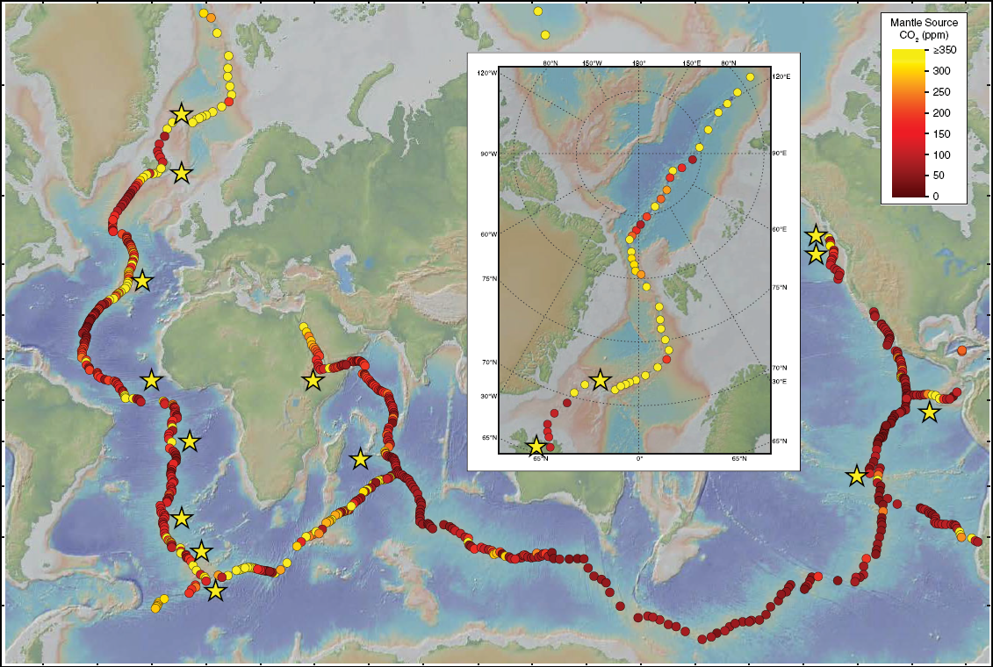
Average mantle source CO₂ concentrations along the global mid-ocean ridge system.
Hauri et al., 2019 [Deep Carbon – Orcutt et al. (Eds.), 237-274]
Notes:
55

Slide 56
The role of volatiles
Etna
Solfatara
>44 kTon/day!
Ischia
Stromboli
Pantelleria
Ustica
Vulcano
Colli Albani
Inguaggiato et al., 2012 (G3, doi:10.1029/2011GC003920)
Notes:
56

Slide 57
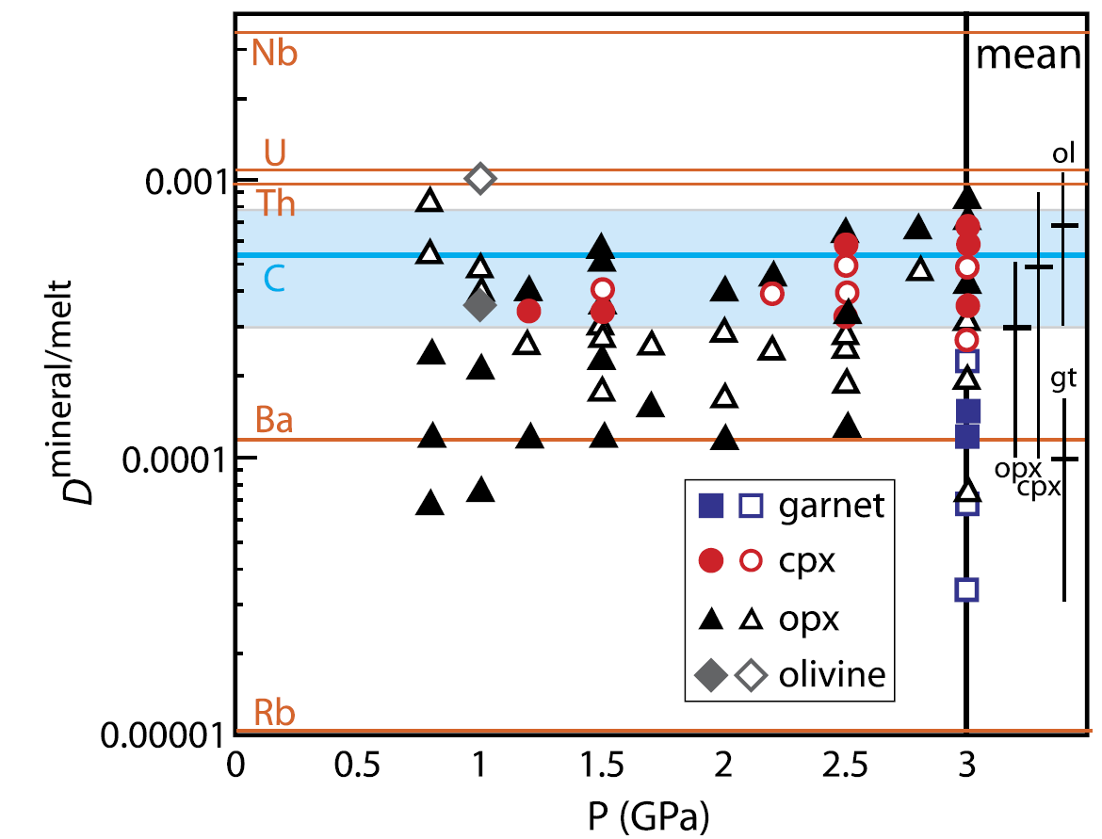
The role of volatiles
Coefficient distributions for C in typical mantle minerals
Average D_{C} for peridotite
C is more incompatible than Nb (lower D), but is more compatible than Ba and Rb (higher D)
Rosenthal et al., 2015 (Earth Planet. Sci. Lett.,412, 77-87)
Notes:
57

Slide 58
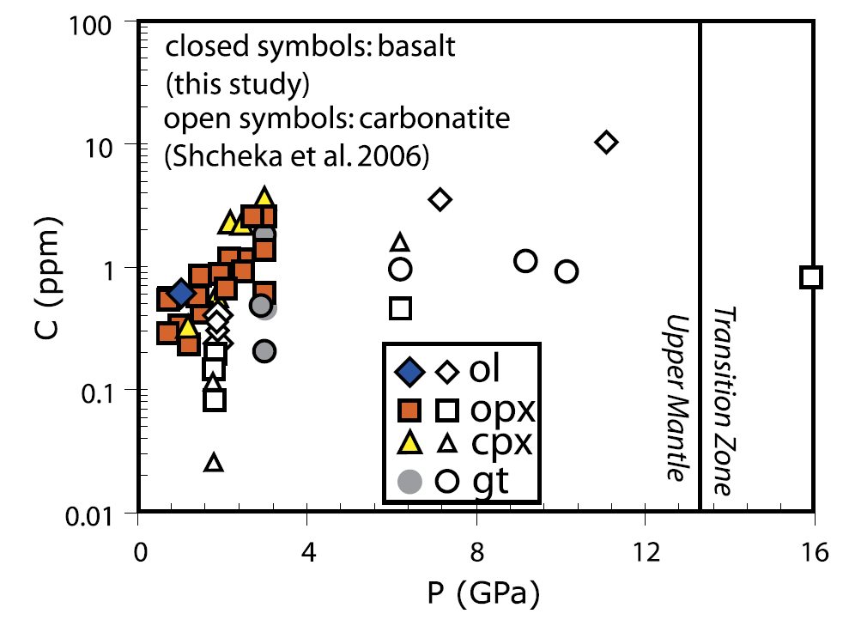
The role of volatiles
Concentration of C in mantle minerals equilibrated with carbonated basalt is always low (generally <3 ppm)
Rosenthal et al., 2015 (Earth Planet. Sci. Lett.,412, 77-87)
Notes:
58

Slide 59
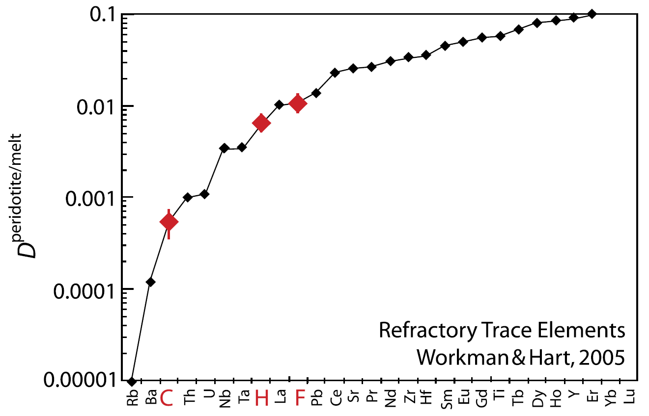
The role of volatiles
Carbon is among the most incompatible elements in the Earth’s mantle.
C is one order of magnitude more incompatible than H
Rosenthal et al., 2015 (Earth Planet. Sci. Lett.,412, 77-87)
C
H
F
Notes:
59

Slide 60
The role of volatiles
Carbon-bearing phases in the mantle
- Upper Mantle -
C is chiefly present in accessory phases. Typical mantle phases can host only few ppm (tens to hundreds ppm). This means that if C is present in larger amounts it stabilizes C-rich phases.
At shallow depth the stable C-bearing phase is Ca-rich (calcite/aragonite). With increasing pressures the carbonate becomes Ca-Mg-Fe-rich (dolomite/ankerite) to Mg-rich (magnesite).
Typically the shallowest mantle is too hot to allow stability of crystalline carbonate and C is dissolved in melts or fluids.
Notes:
60

Slide 61
The role of volatiles
Carbon-bearing phases in the mantle
- Lower Mantle -
Lower mantle may be too reduced to favour stable carbonates.
The most critical parameter controlling the stability of carbonate in lower mantle is the oxygen fugacity. At the present state of knowledge it remains unclear if carbonate can be stable at lower mantle conditions.
More likely, C is hosted in reduced forms like diamond. C can be present also as Fe-Ni carbide (Fe,Ni)₇C₃ or as impurity in Fe-Ni metal.
Dasgupta and Hirschmann, 2010 (Earth Planet. Sci. Lett., 298, 1-13)
Notes:
61

Slide 62
The role of volatiles
At high P (>2 GPa) CO₂ (if present) reacts with silicate minerals to give a carbonate phase according to the reaction:
Cpx + Ol + CO₂ = Dolomite + Opx
How many km deep?
CaMgSi₂O₆ + 2Mg₂SiO₄ + 2CO₂ =
Diopside Forsterite
CaMg(CO₃)₂ + 2Mg₂Si₂O₆
Dolomite Enstatite

Slide 63
The role of volatiles
Carbonates have been observed rarely among mineral inclusions in diamonds and in mantle xenoliths. This rarity is probably due to the same decarbonation reaction acting during decompression in the opposite direction (i.e., consuming dolomite).
Dolomite + Opx = Cpx + Ol + CO₂
Stable ad P >2 GPa
Stable ad P <2 GPa
This reaction is responsible for the formation of wehrlites.
Wehrlites?

Slide 64
The role of volatiles
dolomite + orthopyroxene = clinopyroxene + olivine + CO₂
Olivine
Dunite
90
Wehrlite = Opx-poor Peridotite
Peridotites
Wehrlite
Harzburgite
Lherzolite
40
Olivine Websterite
Pyroxenites
Orthopyroxenite
10
Websterite
Orthopyroxene
10
Clinopyroxene
Clinopyroxenite

Slide 65
The role of volatiles
At higher P (>3-4 GPa), the composition of the carbonate mineral change according to the reaction:
Dolomite + Opx = Cpx + Magnesite
CaMg(CO₃)₂ + Mg₂Si₂O₆ =
Dolomite Enstatite
CaMgSi₂O₆ + 2MgCO₃
Diopside Magnesite

Slide 66
The role of volatiles
To summarize:
Cpx + Ol + CO₂ = Dolomite + Opx
At P >2 GPa
Dolomite + Opx = Cpx + Magnesite
At P >3-4 GPa
Magnesite is richer in Mg than Dolomite.
This means that carbonatitic partial melts at carbonated peridotite solidus are richer in Mg where magnesite is a solidus phase (i.e., at higher depths).

Slide 67
The role of volatiles
Temperature (°C)
1000
1200
1400
1600
2
Fo + Di + CO₂
Dol + En (CMS)
Systems with CO₂ + H₂O
3
Fo+CO₂
Di + CO₂
Mgs+En (CMS)
4
Pressure (GPa)
Mgs + Coes (Eclogite)
Fe-cpx + CO₂
5
Fe addition
Fe-Mgs + Coes (Eclogite)
6
carbonation reactions
7
Hammouda and Keshav, 2015 (Chem. Geol., 418, 171-188)
Notes:
67

Slide 68
The role of volatiles
Are we sure that CO₂ is present in the Earth's mantle?
Yes: CO₂-rich magmas (e.g., carbonatites and Kimberlites) originate at pressures of ~2–8 GPa.
Due to their low density, low viscosity and highly reactive nature, carbonatite melts and fluids are the most important metasomatic agents in the lithospheric mantle.

Slide 69
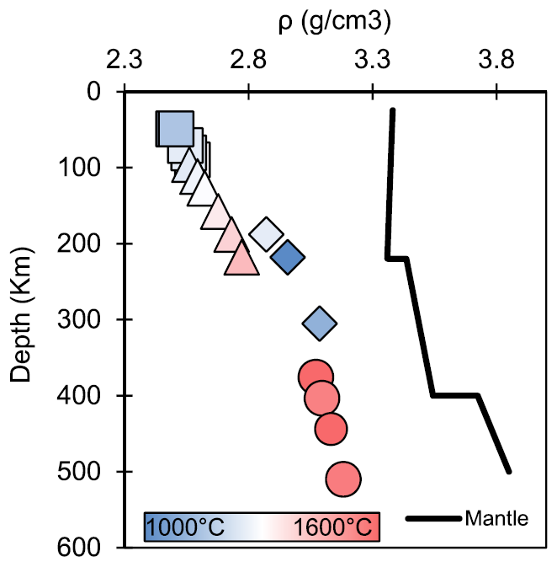
The role of volatiles
Negative density of primary MgCO₃-CaCO₃ carbonatite melts in contrast with the surrounding mantle (PREM).
Hurt and Wolf, 2020 (Earth Planet. Sci. Lett., 531, 115927)

Slide 70
The role of volatiles
Although the Earth’s mantle contains significant amounts of C, all present-day volcanoes except Oldoinyo Lengai (Tanzania) emit C exclusively as CO₂ and not carbonatite.
WHY?
This is because Fe, Ca and Mg carbonatite liquids are not stable at low pressure and break down to produce the CO₂ present in all volcanic emissions.
Carbonatite magmas can erupt at Oldoinyo Lengai as a result of their high Na contents; unlike calcic or magnesian carbonate liquids, natrocarbonatite liquids are stable at atmospheric pressure.
Fisher et al., 2009, Nature, 459, 77-80)

Slide 71
The role of volatiles
Geologic CO₂ degassing in Italy
Volcanic
Non Volcanic*
Crater emission
Mt. Etna (1976-1985)
Mt. Etna (1993-1997)
Stromboli Is.
Vulcano Is.
Ground emission
Vulcano Fossa crater
Vulcano plains
Vulcano fumaroles
Stromboli
Vesuvius
Solfatara (Phl. Fields)
Ischia Is.
25 (13-44)
4-13
1-2
0.066
0.073
0.027
0.088
0.08
0.5
1.8
0.14
Regional
Central Italy (45,000 km²)
Central Apennines
Tuscany and N Latium
Campania
Soil degassing
Latera, Vulsini Mts.
Alban Hills
Siena graben
Ustica Is.
Geothermal Fields
Mt. Amiata, Tuscany
9.7-17
4-13.2
6
3
>0.07
0.2
>0.5
0.02
0.5
Output (Mt/yr)
Output (Mt/yr)
* Means not related to active volcanic systems (crater and flanks of volcanoes)
Frezzotti et al., 2009 (Chem. Geol., 262, 108-120)

Slide 72
The role of volatiles
Where does the Carbon derive from?
The principal mechanism of ingassing of C to the Earth’s interior is SUBDUCTION.
Three are the main lithologies that are recycled along subduction zones: 1) Marine Sediments; 2) Basaltic Crust; 3) Underlying Lithospheric Mantle.
All these three lithologies can be C-rich.
Sediments can deliver to depths ~1-2 * 10¹³ g of C/yr.
Typical 7 km-thick basaltic crust with ~0.3 wt% C can deliver to depths ~6 * 10¹³ g of C/yr.
Lithospheric mantle can be as rich as 11 wt% of C (ophicarbonate), possibly fluxing ~6-11 + 10¹³ g/yr of C via subduction.
Dasgupta and Hirschmann, 2010 (Earth Planet. Sci. Lett., 298, 1-13)

Slide 73
The role of volatiles
Where does the Carbon derive from?
This cartoon illustrates the Carbon input and output fluxes in grams of C/(km*yr) at the Central America
convergent margin.
Estimates of the carbon flux at the outer fore arc, the volcanic front, and the back arc at the Central America convergent margin represent <12% of the
total sedimentary carbon input into the subduction zone.
This means that most of the C entering subduction zones may be recycled to the deeper mantle.
Furi et al., 2010 (G3 doi:10.1029/2009GC002810)
Notes:
73

Slide 74
The role of volatiles
Where does the Carbon derive from?
This cartoon illustrates the Carbon input and output fluxes in grams of C/(km*yr) at the Central America
convergent margin.
Note, however, that C outgassing occurs not only through arc volcanism, but also along oceanic ridges and intraplate settings.
At the present state of knowledge we do not know if the net flux of surficial of C is positive or negative.
Estimates of the carbon flux at the outer fore arc, the volcanic front, and the back arc at the Central America convergent margin represent <12% of the
total sedimentary carbon input into the subduction zone.
This means that most of the C entering subduction zones may be recycled to the deeper mantle.
Furi et al., 2010 (G3 doi:10.1029/2009GC002810)
Notes:
74

Slide 75
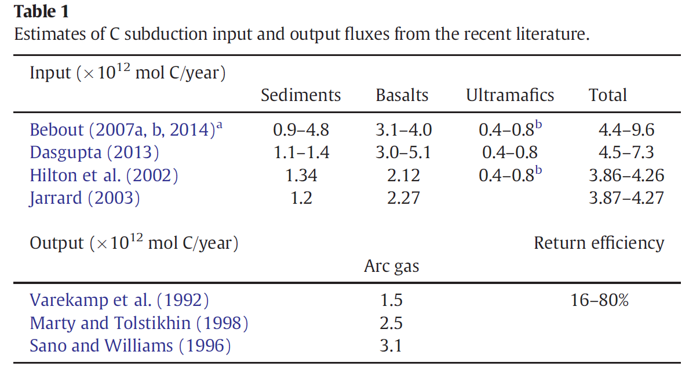
The role of volatiles
Collins et al., 2015 (Chem. Geol., 412, 132-150)
Notes:
75

Slide 76
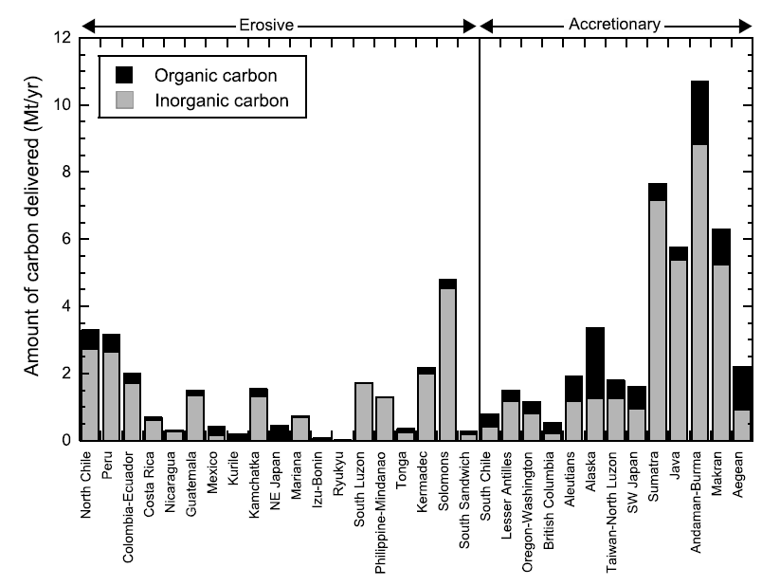
The role of volatiles
~60 Mton C/year subducted
~48 Mton inorganic C
~12 Mton organic C
Clift, 2017 (Rev. Geophys., 55, 97–125)
Notes:
76

Slide 77
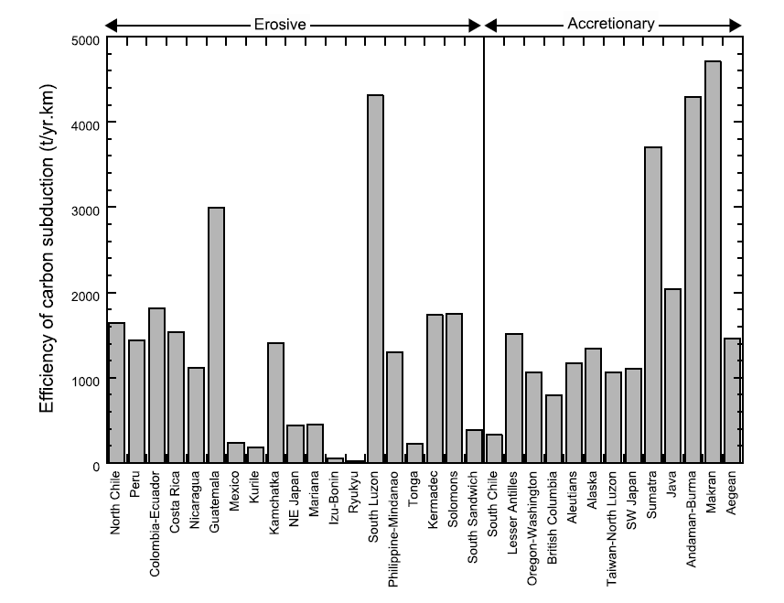
The role of volatiles
Amount of C subducted below the forearc in ton/year per km
~60 Mton C/year subducted
~48 Mton inorganic C
~12 Mton organic C
Clift, 2017 (Rev. Geophys., 55, 97–125)
Notes:
77

Slide 78
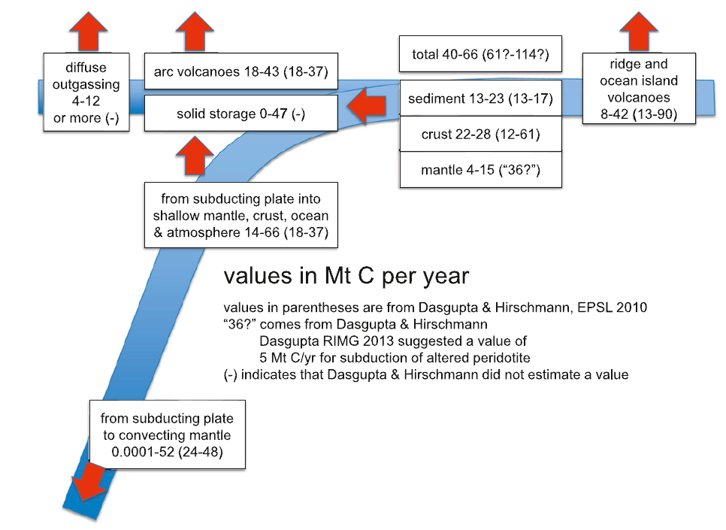
The role of volatiles
C carried by the subducting plate
Return efficiency:
~0-79%
Kelemen and Manning, 2015 (Proc. Natl. Acad. Sci., 112, 3997-4006)
Notes:
78

Slide 79
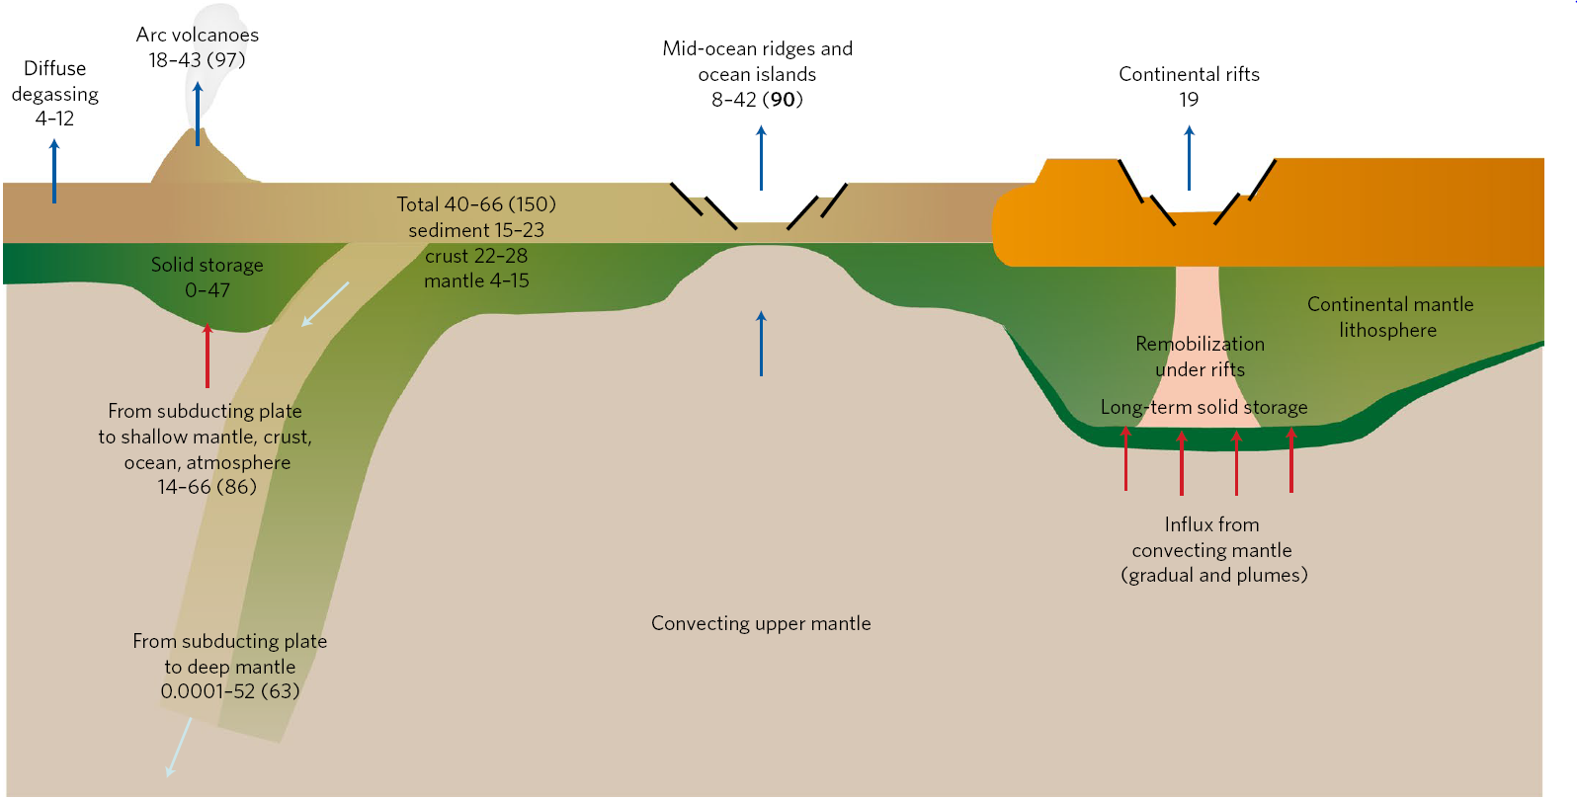
The role of volatiles
18-97
8-90
19-170
4-12
40-150
0-47
14-86
0.0001-63
Carbon fluxes in Mt/yr
Foley and Fisher, 2017 (Nature Geosci., 10, 897-902)
Notes:
79

Slide 80
The role of volatiles
Are carbonatites common in the circum-Mediterranean region?
ABSOLUTELY NO.
Very few and scarce occurrences (Canaries, Morocco, Spain, France, Germany and Italy).
So:
WHY DO WE SPEND PRECIOUS TIME WITH THIS RARE STUFF?
Because a (wrong) axiom has been often proposed in literature:
Carbonatites? Presence of mantle plume!

Slide 81
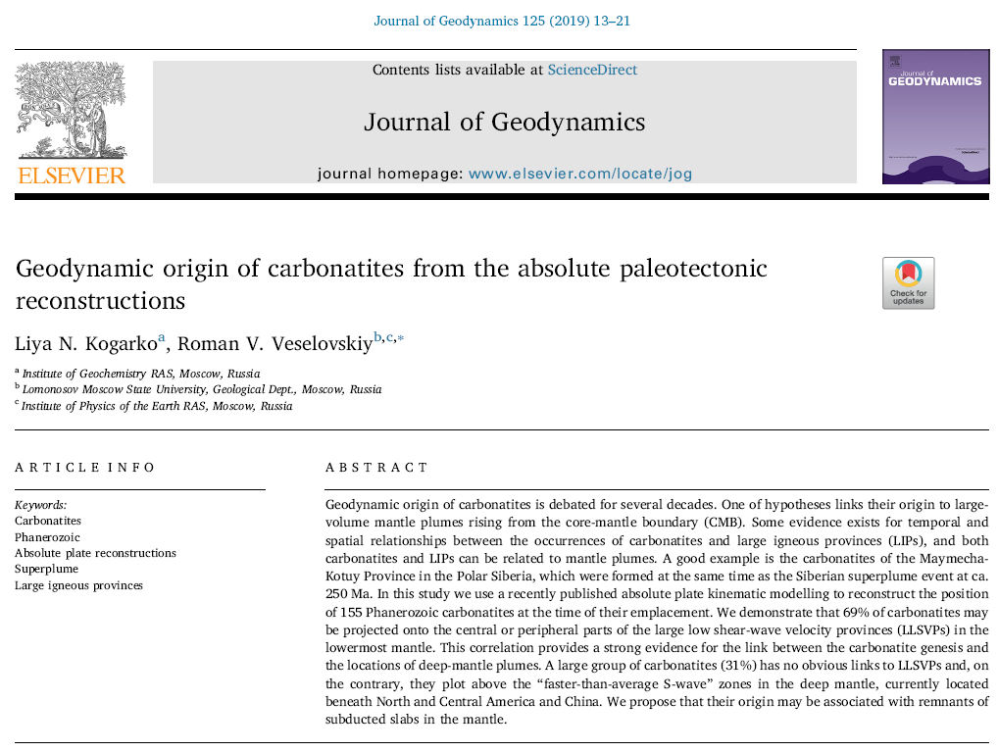
The role of volatiles

Slide 82
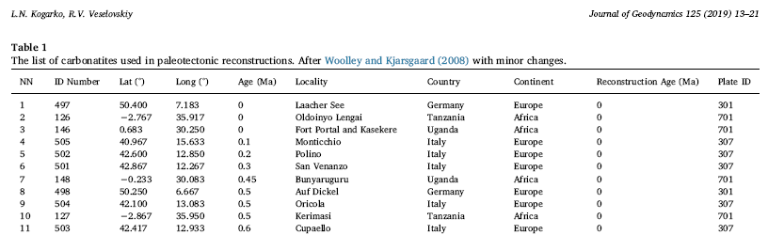
The role of volatiles
The ultimate carbonatitic origin of the Italian localities (and their connection to alleged “mantle plumes”) is strongly debated.

Slide 83
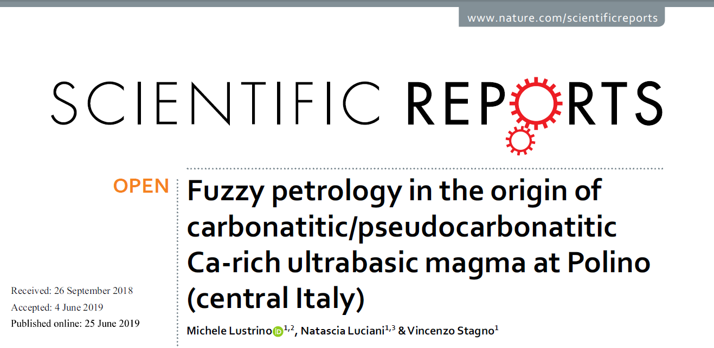
The role of volatiles

Slide 84
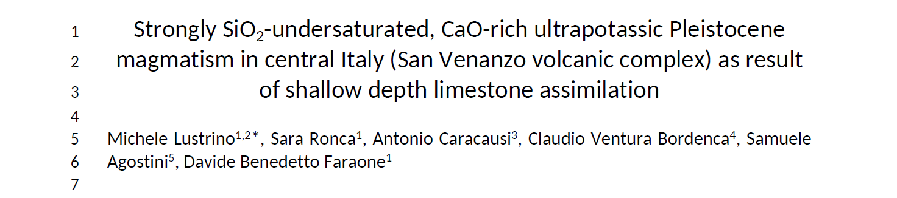
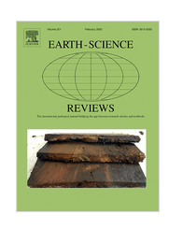
The role of volatiles
[…] Major and trace element contents indicate a general depletion proportional to the amount of carbonate (exemplified by the CaO content). The observed trends in Harker-type diagrams are compatible with a process of variable interaction between a silicatic magma with sedimentary marly carbonates.
[…] Major and trace element contents indicate a general depletion proportional to the amount of carbonate (exemplified by the CaO content). The observed trends in Harker-type diagrams are compatible with a process of variable interaction between a silicatic magma with sedimentary marly carbonates.
In press

Slide 85
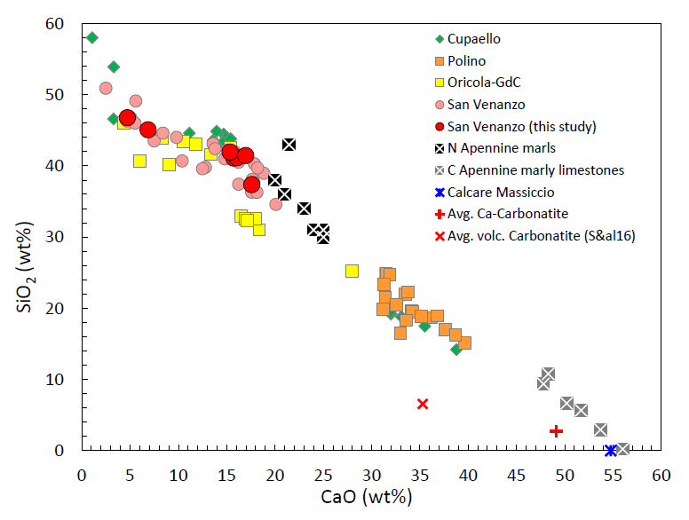
The role of volatiles
In press

Slide 86
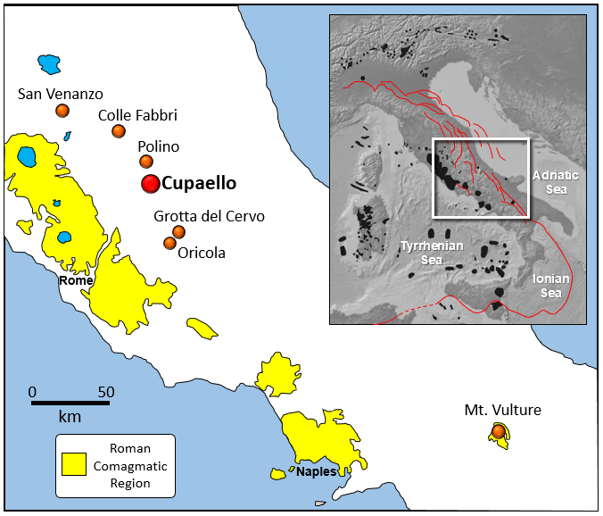
The role of volatiles
(Monticchio)

Slide 87
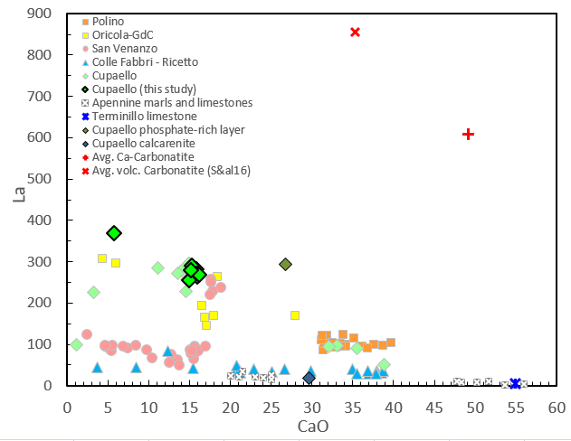
The role of volatiles
Average La content of carbonatitic magmas
Ca-rich “carbonatitic” melts with low incompatible element content → interaction with sedimentary carbonates.
CaO range of typical basaltic melts

Slide 88
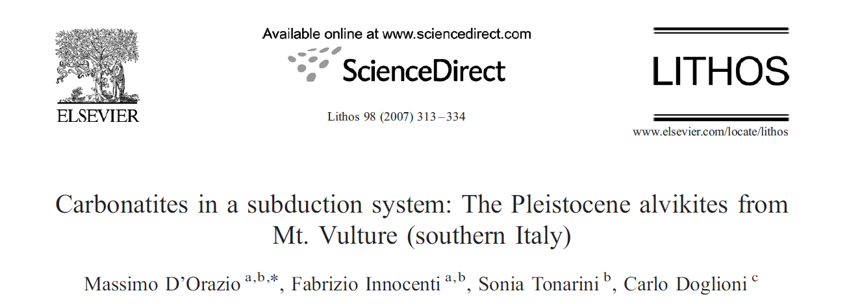
The role of volatiles

Slide 89
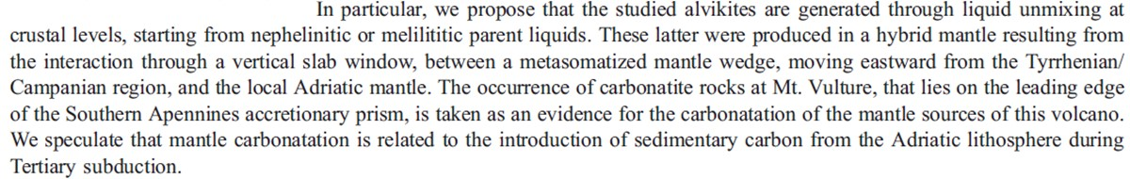
The role of volatiles
[…] the carbonatite liquid crystallizing to form the studied alvikites did not represent a primary magma rising directly from the mantle, but most likely originated by liquid unmixing at shallow level, starting from a CO₂-rich melilitite/nephelinite parental melt
[…] the CO₂-rich nature of the mantle source of Mt. Vulture, able to generate silicate melts evolving to carbonatite, is related to the input of marine carbonates and sedimentary organic carbon, carried at mantle depths by the subduction of the Adriatic lithosphere.

Slide 90
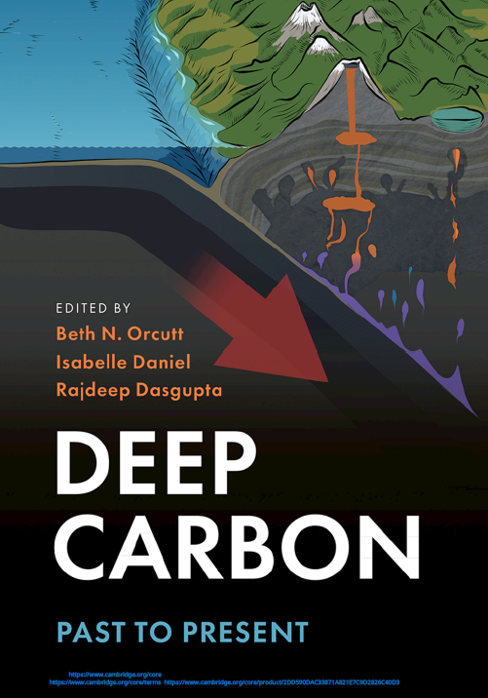
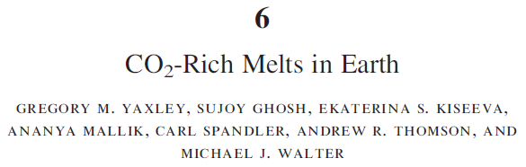
The role of volatiles
Carbonatite-Mantle Plume connection?
No, thanks
Carbonatites form:
“via low-degree (and hence relatively low temperature) melting of fertile mantle sources, such as thick mantle lithosphere beneath stable cratons.” […] “This would be consistent with more effective recycling of crustal material into the mantle via modern-style subduction processes, allowing the production of the refertilized mantle domains that are requisite sources of these magmas.”
2019
(freely downloadable from the web)

Slide 91
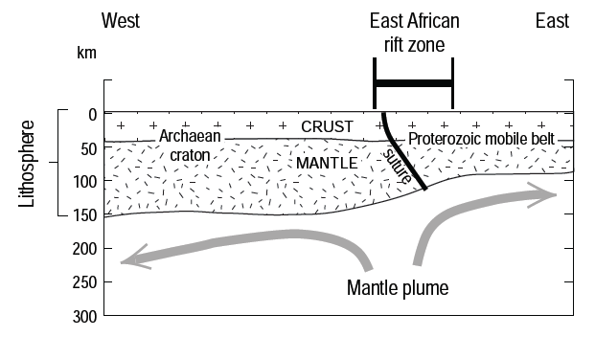
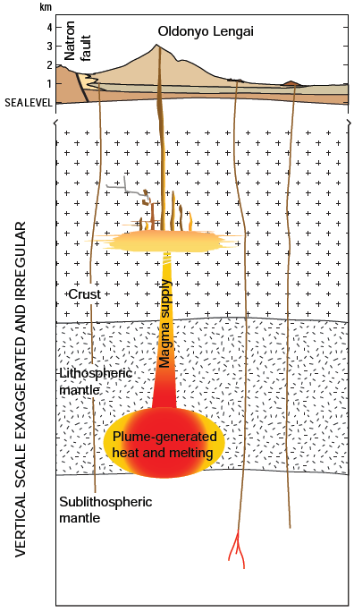
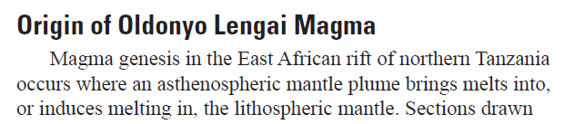
The role of volatiles
“Asthenospheric mantle plume”
=
Normal asthenospheric melt upwelling…
Sherrod et al., 2013 (USGS Open File Report 2013-1306 http://dx.doi.org/10.3133/ofr20131306)

Slide 92

The role of volatiles
carbonatite melts and fluids are the most important metasomatic agents in the lithospheric mantle.
METASOMATISM
Metasomatism?
Metasomatic Agents?
Mmmh…
Important and fundamental concepts in modern igneous petrology but too often used as “magic words” to explain what is difficult to explain…
We will come back later on these arguments, no matter.

Slide 93
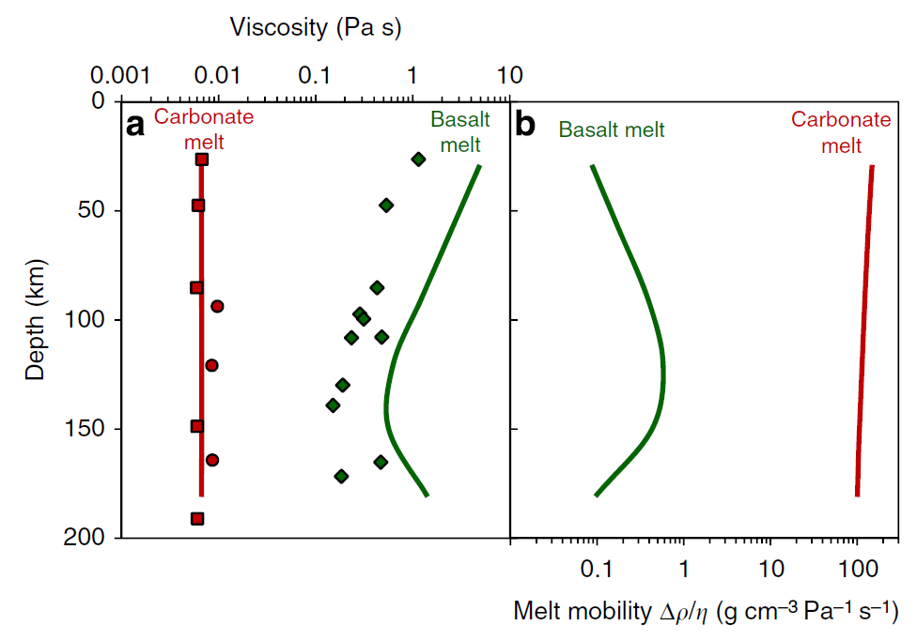
Carbonatitic melts are two to three orders of magnitude less viscous and more mobile than basaltic melts!
Water viscosity at room conditions
@T 1380-1790 °C
Olive Oil viscosity
Viscosity
Density contrast between solid rock and melt
Kono et al., 2014 (Nature Comm., 5, 5091 doi: 10.1038/ncomms6091)

Slide 94
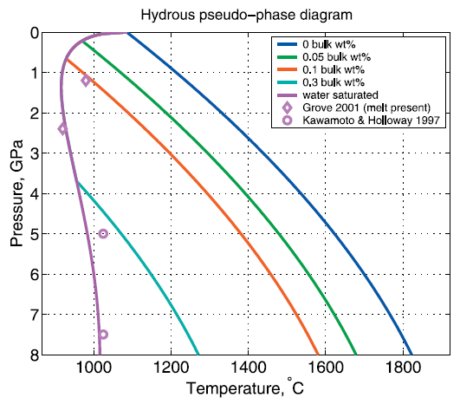
Simplified Solidus for Lherzolite + H₂O system
Simplified solidus for different bulk water contents of the system.
Katz et al., 2003 (Geochem. Geophys. Geosyst. doi:10.1029/2002GC000433)

Slide 95
Did you really understand the significance of these curves?
This is the solidus for a given dry starting assemblage (it varies depending on the compositions used).
This is the H₂O-saturated solidus (i.e., for H₂O content
greater than that contained in pargasite or any other H₂O-bearing mineral).
These are H₂O-undersaturated solidi (i.e., for H₂O content lower that can be contained in pargasite).
In this case the solidus is given by the amphibole stability limit.

Slide 96
Did you really understand the significance of these curves?
This is the solidus for a given dry starting assemblage (it varies depending on the compositions used).
This is the H₂O-saturated solidus (i.e., for H₂O content
greater than that contained in pargasite or any other H₂O-bearing mineral).
These are H₂O-undersaturated solidi (i.e., for H₂O content lower that can be contained in pargasite).
In this case the solidus is given by the amphibole stability limit.
ΔT ~500 °C
Adding <0.5 wt% water to peridotite can lower solidus temperature of ~500 °C @ 3 GPa or ~800 °C @ 8 GPa
ΔT ~800 °C

Slide 97
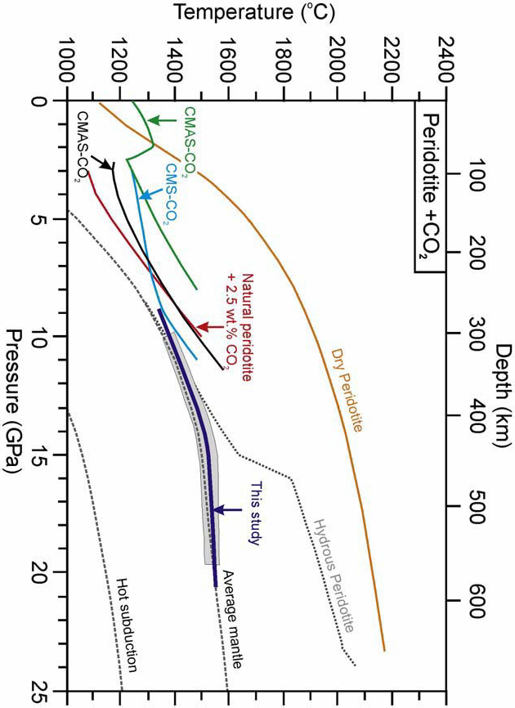
Simplified Solidus for Lherzolite + CO₂ + H₂O system
The average dry mantle solidus is the red line.
Here also several mantle solidi obtained on different H-C-bearing starting assemblages are reported (CMS-CO₂; CMAS-CO₂; CMAS-CO₂+H₂O; Natural Peridotite+CO₂; Natural peridotite+Alkalies+CO₂).
Ghosh et al., 2009 (Chem. Geol., 262, 17-28)

Slide 98
Simplified Solidus for Lherzolite + CO₂ + H₂O system
Peridotite + CO₂
~500 °C
The average dry mantle solidus is the red line.
Adding CO₂ + H₂O to peridotite increases the complexity of the system.
~500 °C
…but a common effect can be easily noted…
Ghosh et al., 2009 (Chem. Geol., 262, 17-28)

Slide 99
Simplified Solidus for Lherzolite + CO₂ + H₂O system
0
Volatile-free
Solidus
Hypothetical
Geotherm
100
In this case the geotherm never intersects the dry solidus.
This means that partial melting is not possible under completely dry conditions.
200
Depth (km)
300
400
500
1000
1500
Temperature (°C)
Wyllie and Riabchikov, 2000 (J. Petrol., 41, 1195-1206)

Slide 100
Simplified Solidus for Lherzolite + CO₂ + H₂O system
0
Volatile-free
Solidus
Hypothetical
Geotherm
100
Solidus
(CO₂+H₂O)
The red line indicates the carbonated peridotite solidus.
In such an example, the local temperature of the mantle (geotherm) is higher than the solidus in a large depth interval.
200
Next
Figure
Depth (km)
300
400
500
1000
1500
Temperature (°C)
Wyllie and Riabchikov, 2000 (J. Petrol., 41, 1195-1206)
Notes:
100

Slide 101
Melting relationships for pyrolite ± (C+H+O) of the shallow mantle.
TEMPERATURE (°C)
400
800
1200
1600
Oceanic Intraplate
Geotherm
C-H-free
Solidus
Dehydration
Solidus
The petrological base of the lithosphere defined by the high pressure pargasite breakdown and a silicate solidus at ~3 GPa.
This is because pargasite breakdown is always accompanied by melting.
30
1
Plagioclase
Major
Melting
Shield
Continental
Intraplate
Geotherm
Spinel
Garnet
60
2
LITHOSPHERE
Amphibole + Carbonate or Carbonatite Melt
fO₂ = IW +3 +4
PRESSURE (GPa)
DEPTH (km)
Pargasite
90
3
Incipient
Melting
ASTHENOSPHERE
120
4
Silicate Melt + Dissolved CO₃ and OH
fO₂ = IW +2
Partial Melt present
CARBONATITE MELT
Adiabatic
Upwelling
150
5
SUB-ASTHENOSPHERE
D.H. Green (http://www.mantleplumes.org/MantleTemp.html)
Subsolidus
fO₂ = IW +1

Slide 102
The base of the asthenosphere (incipient melting regime along the geotherm) is drawn arbitrarily at ~150 km as the intersection of a mantle adiabat of potential temperature Tp =1450 °C with the pyrolite-(C+H+O) solidus for fO₂ = IW+1.
Below this depth, a fluid with CH₄ ± H₂O is present but there is no silicate melt unless fO₂ > IW+1, i.e. a more oxidized region of the mantle.
TEMPERATURE (°C)
400
800
1200
1600
Oceanic Intraplate
Geotherm
C-H-free
Solidus
Dehydration
Solidus
30
1
Plagioclase
Major
Melting
Shield
Continental
Intraplate
Geotherm
Spinel
Garnet
60
2
LITHOSPHERE
Amphibole + Carbonate or Carbonatite Melt
fO₂ = IW +3 +4
PRESSURE (GPa)
DEPTH (km)
Pargasite
90
3
Incipient
Melting
ASTHENOSPHERE
120
4
Silicate Melt + Dissolved CO₃ and OH
fO₂ = IW +2
Partial Melt present
CARBONATITE MELT
Adiabatic
Upwelling
150
5
SUB-ASTHENOSPHERE
D.H. Green (http://www.mantleplumes.org/MantleTemp.html)
Subsolidus
fO₂ = IW +1

Slide 103
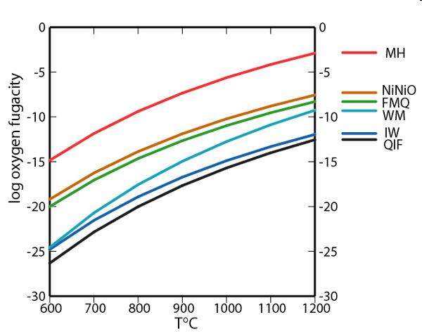
Do you know (or remember) the significance of Oxygen buffers?
More Oxidizing
Average upper mantle value
Magnetite + Quartz = Fayalite + O₂
2Fe₃O₄ 3SiO₂ 3Fe₂SiO₄
In other words, when the oxygen fugacity is low only Fe²⁺ phases are present (Fayalite).
When oxygen fugacity is high also Fe³⁺-bearing phases are present (magnetite).
M
Q
F
More Reducing

Slide 104
Do you know (or remember) the significance of Oxygen buffers?
More Oxidizing
Average upper mantle value
Magnetite + Quartz = Fayalite + O₂
2Fe₃O₄ 3SiO₂ 3Fe₂SiO₄
IMPORTANT:
This does not mean that Fayalite or Magnetite are really present in the mantle.
M
Q
F
More Reducing

Slide 105
If the peridotite system is sufficiently oxidized (i.e., both CO₂ and H₂O are present), the Oceanic Geotherm crosses the solidus at shallower depths up to deeper levels.
TEMPERATURE (°C)
400
800
1200
1600
Oceanic Intraplate
Geotherm
C-H-free
Solidus
Dehydration
Solidus
30
1
Plagioclase
Major
Melting
Shield
Continental
Intraplate
Geotherm
Spinel
Garnet
60
2
LITHOSPHERE
LITHOSPHERE
Under these conditions (e.g., oxidized and with free CO₂ and H₂O), the asthenosphere would occupy a larger volume of the mantle.
Amphibole + Carbonate or Carbonatite Melt
fO₂ = IW +3 +4
PRESSURE (GPa)
DEPTH (km)
Pargasite
90
3
Incipient
Melting
ASTHENOSPHERE
120
4
Silicate Melt + Dissolved CO₃ and OH
fO₂ = IW +2
Partial Melt present
CARBONATITE MELT
More oxidized conditions means fO₂ = IW>+3 (~FMQ)
Adiabatic
Upwelling
150
5
SUB-ASTHENOSPHERE
D.H. Green (http://www.mantleplumes.org/MantleTemp.html)
Subsolidus
fO₂ = IW +1

Slide 106
The Sky Blue Line indicates the melting curve for the C-H-free system.
TEMPERATURE (°C)
400
800
1200
1600
Oceanic Intraplate
Geotherm
C-H-free
Solidus
Dehydration
Solidus
30
1
Plagioclase
Shield
Continental
Intraplate
Geotherm
Spinel
Garnet
60
2
LITHOSPHERE
Major
Melting
Amphibole + Carbonate or Carbonatite Melt
fO₂ = IW +3 +4
PRESSURE (GPa)
DEPTH (km)
Pargasite
90
3
Incipient
Melting
ASTHENOSPHERE
120
4
Silicate Melt + Dissolved CO₃ and OH
fO₂ = IW +2
CARBONATITE MELT
Adiabatic
Upwelling
150
5
SUB-ASTHENOSPHERE
D.H. Green (http://www.mantleplumes.org/MantleTemp.html)
Subsolidus
fO₂ = IW +1

Slide 107
The Yellow Line indicates the melting curve for the system Peridotite + H₂O + CO₂ (Oxidized Conditions).
Remember the carbonatation reaction that occurs at P >2 GPa:
Ol + Cpx + CO₂ =
Opx + Dolomite
TEMPERATURE (°C)
400
800
1200
1600
Oceanic Intraplate
Geotherm
C-H-free
Solidus
Dehydration
Solidus
Depth at which carbonatation reaction occurs
30
1
Plagioclase
Shield
Continental
Intraplate
Geotherm
Spinel
Garnet
60
2
LITHOSPHERE
Major
Melting
Amphibole + Carbonate or Carbonatite Melt
fO₂ = IW +3 +4
PRESSURE (GPa)
DEPTH (km)
Pargasite
90
3
Incipient
Melting
What does “Carbonatated Mantle” mean?
ASTHENOSPHERE
120
4
Silicate Melt + Dissolved CO₃ and OH
fO₂ = IW +2
CARBONATITE MELT
Adiabatic
Upwelling
Peridotitic (silicatic) mantle + stable carbonate mineral
150
5
SUB-ASTHENOSPHERE
D.H. Green (http://www.mantleplumes.org/MantleTemp.html)
Subsolidus
fO₂ = IW +1

Slide 108
The Yellow Line indicates the melting curve for the system Peridotite + H₂O + CO₂ (Oxidized Conditions).
At these depths dolomite becomes the solidus phase and the solidus is strongly depressed with formation of carbonatitic melts.
TEMPERATURE (°C)
400
800
1200
1600
Oceanic Intraplate
Geotherm
C-H-free
Solidus
Dehydration
Solidus
Depth at which carbonatation reaction occurs
30
1
Plagioclase
Shield
Continental
Intraplate
Geotherm
Spinel
Garnet
60
2
LITHOSPHERE
Major
Melting
Amphibole + Carbonate or Carbonatite Melt
fO₂ = IW +3 +4
PRESSURE (GPa)
DEPTH (km)
Pargasite
90
3
Incipient
Melting
ASTHENOSPHERE
120
4
Silicate Melt + Dissolved CO₃ and OH
fO₂ = IW +2
CARBONATITE MELT
Adiabatic
Upwelling
150
5
SUB-ASTHENOSPHERE
D.H. Green (http://www.mantleplumes.org/MantleTemp.html)
Subsolidus
fO₂ = IW +1

Slide 109
The Yellow Line indicates the melting curve for the system Peridotite + H₂O + CO₂ (Oxidized Conditions).
What does this mean?
TEMPERATURE (°C)
400
800
1200
1600
Oceanic Intraplate
Geotherm
C-H-free
Solidus
Dehydration
Solidus
Depth at which carbonatation reaction occurs
30
1
Plagioclase
Shield
Continental
Intraplate
Geotherm
Spinel
Garnet
60
2
LITHOSPHERE
Major
Melting
Amphibole + Carbonate or Carbonatite Melt
fO₂ = IW +3 +4
~400 °C
PRESSURE (GPa)
DEPTH (km)
Pargasite
90
As soon as carbonate stabilizes in the mantle, the solidus temperature of the carbonated peridotite is immediately lowered.
The solidus of a carbonated peridotite is ~400 °C lower than a C-H-free peridotite!
3
Incipient
Melting
ASTHENOSPHERE
120
4
Silicate Melt + Dissolved CO₃ and OH
fO₂ = IW +2
CARBONATITE MELT
Adiabatic
Upwelling
150
5
SUB-ASTHENOSPHERE
D.H. Green (http://www.mantleplumes.org/MantleTemp.html)
Subsolidus
fO₂ = IW +1
Notes:
109

Slide 110
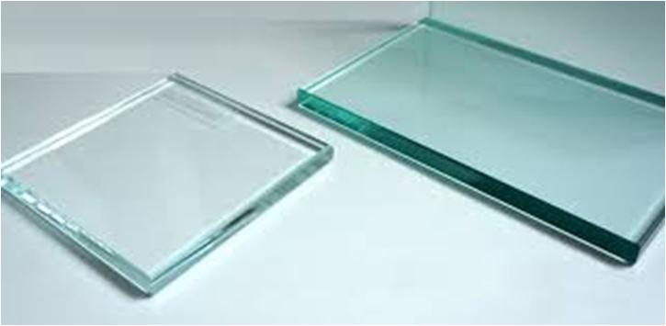
What is the standard glass made of?
Pure SiO₂?
No, of course.
Quartz melting temperature is very high (~1700 °C)
Common glass is made up by:
Oxide | % min | % max
SiO₂ | 68,0 | 74,5
Al₂O₃ | 0,0 | 4,0
Fe₂O₃ | 0,0 | 0,45
CaO | 9,0 | 14,0
MgO | 0,0 | 4,0
Na₂O | 10,0 | 16,0
K₂O | 0,0 | 4,0
SO₃ | 0,0 | 0,3
SiO₂ ~60%
Na₂CO₃ ~18%,
CaMg(CO₃)₂ ~17%
CaO ~4%,
CaSO₄ ~1%.
The melting T of this mixture can be as low as 1000 °C
Notes:
110

Slide 111

Volatile-free peridotite melts
Carbonated peridotite melts
For a fixed melt fraction, carbonated silicate melt stabilizes at lower T than silicate melts from a volatile-free peridotite
Ghosh et al., 2014 (Contrib. Mineral. Petrol., 167, 964)
12% melting
Notes:
111

Slide 112
The Red Line indicates the melting curve for the system Peridotite + H₂O + CH₄ (Reduced Conditions).
In this case no carbonate is stable as solidus phase and therefore no carbonatitic melt is produced.
The shape of the solidus is mainly influenced by the amphibole breakdown.
TEMPERATURE (°C)
400
800
1200
1600
Oceanic Intraplate
Geotherm
C-H-free
Solidus
Dehydration
Solidus
30
1
Plagioclase
Shield
Continental
Intraplate
Geotherm
Spinel
Depth at which amphibole is unstable.
60
Garnet
2
LITHOSPHERE
Major
Melting
Amphibole + Carbonate or Carbonatite Melt
fO₂ = IW +3 +4
PRESSURE (GPa)
DEPTH (km)
Pargasite
90
3
Incipient
Melting
ASTHENOSPHERE
120
4
Silicate Melt + Dissolved CO₃ and OH
fO₂ = IW +2
CARBONATITE MELT
Adiabatic
Upwelling
150
5
SUB-ASTHENOSPHERE
D.H. Green (http://www.mantleplumes.org/MantleTemp.html)
Subsolidus
fO₂ = IW +1

Slide 113
The Red Line indicates the melting curve for the system Peridotite + H₂O + CH₄ (Reduced Conditions).
Amphibole is the main carrier of H₂O at typical geotherm temperatures.
At P <3 GPa, if H₂O is present in the mantle, it is stored in the amphibole (this means that there is no over-saturation of H₂O).
TEMPERATURE (°C)
400
800
1200
1600
Oceanic Intraplate
Geotherm
C-H-free
Solidus
Dehydration
Solidus
30
1
Plagioclase
Shield
Continental
Intraplate
Geotherm
Spinel
Depth at which amphibole is unstable.
60
Garnet
2
LITHOSPHERE
Major
Melting
Amphibole + Carbonate or Carbonatite Melt
fO₂ = IW + 3.4
PRESSURE (GPa)
DEPTH (km)
Pargasite
90
3
Incipient
Melting
ASTHENOSPHERE
120
4
Silicate Melt + Dissolved CO₃ and OH
fO₂ = IW +2
CARBONATITE MELT
Adiabatic
Upwelling
150
5
SUB-ASTHENOSPHERE
D.H. Green (http://www.mantleplumes.org/MantleTemp.html)
Subsolidus
fO₂ = IW +1
Notes:
113

Slide 114
The Red Line indicates the melting curve for the system Peridotite + H₂O + CH₄ (Reduced Conditions).
At P >3 GPa, amphibole is no longer stable and the H₂O present in its lattice appears as free fluid phase (i.e., the system becomes H₂O over-saturated).
When free H₂O is present, the solidus temperature is sensibly lowered.
TEMPERATURE (°C)
400
800
1200
1600
Oceanic Intraplate
Geotherm
C-H-free
Solidus
Dehydration
Solidus
30
1
Plagioclase
Shield
Continental
Intraplate
Geotherm
Spinel
Depth at which amphibole is unstable.
60
Garnet
2
LITHOSPHERE
Major
Melting
Amphibole + Carbonate or Carbonatite Melt
fO₂ = IW + 3.4
PRESSURE (GPa)
DEPTH (km)
Pargasite
90
3
Incipient
Melting
~500 °C
ASTHENOSPHERE
The solidus of a hydrous peridotite is ~500 °C lower than a C-H-free peridotite!
120
4
Silicate Melt + Dissolved CO₃ and OH
fO₂ = IW + 2
CARBONATITE MELT
Adiabatic
Upwelling
150
5
SUB-ASTHENOSPHERE
D.H. Green (http://www.mantleplumes.org/MantleTemp.html)
Subsolidus
fO₂ = IW + 1
Notes:
114

Slide 115
The Red Line indicates the melting curve for the system Peridotite + H₂O + CH₄ (Reduced Conditions).
Note that the solidus temperature of an hydrous peridotite is lowered also at P <3 GPa (i.e., when amphibole is stable).
This because amphiboles melts earlier (at lower T) compared with other silicate anhydrous phases (olivine, pyroxenes, sp/gt).
TEMPERATURE (°C)
400
800
1200
1600
Oceanic Intraplate
Geotherm
C-H-free
Solidus
Dehydration
Solidus
30
1
Plagioclase
Shield
Continental
Intraplate
Geotherm
~150 °C
Spinel
Depth at which amphibole is unstable.
60
Garnet
2
LITHOSPHERE
~200 °C
Major
Melting
Amphibole + Carbonate or Carbonatite Melt
fO₂ = IW + 3.4
PRESSURE (GPa)
~250 °C
DEPTH (km)
Pargasite
90
3
Incipient
Melting
~500 °C
ASTHENOSPHERE
The solidus of a hydrous peridotite is ~500 °C lower than a C-H-free peridotite!
120
4
Silicate Melt + Dissolved CO₃ and OH
fO₂ = IW + 2
CARBONATITE MELT
Adiabatic
Upwelling
150
5
SUB-ASTHENOSPHERE
D.H. Green (http://www.mantleplumes.org/MantleTemp.html)
Subsolidus
fO₂ = IW + 1
Notes:
115

Slide 116
The Green Line indicates the melting curve for the system Peridotite + CO₂ (without H₂O).
In this case there is no role for pargasite breakdown (being as this system H₂O-free).
The solidus is sensibly lower compared to CO₂-free peridotite but there is no important “kink”.
TEMPERATURE (°C)
400
800
1200
1600
Oceanic Intraplate
Geotherm
C-H-free
Solidus
Dehydration
Solidus
30
1
Plagioclase
Shield
Continental
Intraplate
Geotherm
Spinel
Garnet
60
2
LITHOSPHERE
Major
Melting
Amphibole + Carbonate or Carbonatite Melt
fO₂ = IW +3 +4
PRESSURE (GPa)
DEPTH (km)
Pargasite
90
3
Incipient
Melting
ASTHENOSPHERE
120
4
Silicate Melt + Dissolved CO₃ and OH
fO₂ = IW +2
CARBONATITE MELT
Adiabatic
Upwelling
150
5
SUB-ASTHENOSPHERE
D.H. Green (http://www.mantleplumes.org/MantleTemp.html)
Subsolidus
fO₂ = IW +1

Slide 117
TEMPERATURE (°C)
CO₂ (as well as H₂O) promotes melting at low temperatures in peridotites.
The melting temperature for peridotite with both CO₂ and H₂O is lower than with either CO₂ or H₂O alone (below 1000°C at 2-3 GPa).
400
800
1200
1600
Oceanic Intraplate
Geotherm
C-H-free
Solidus
Dehydration
Solidus
30
1
Plagioclase
Shield
Continental
Intraplate
Geotherm
Spinel
Garnet
60
2
LITHOSPHERE
Major
Melting
Amphibole + Carbonate or Carbonatite Melt
fO₂ = IW +3 +4
PRESSURE (GPa)
DEPTH (km)
Pargasite
90
3
Incipient
Melting
ASTHENOSPHERE
120
4
Silicate Melt + Dissolved CO₃ and OH
fO₂ = IW +2
CARBONATITE MELT
Adiabatic
Upwelling
150
5
SUB-ASTHENOSPHERE
D.H. Green (http://www.mantleplumes.org/MantleTemp.html)
Subsolidus
fO₂ = IW +1

Slide 118
TO RESUME:
When no C (CO₂) or H (H₂O) is present, the solidus temperature of a peridotite is relatively high.
If H₂O is present, the solidus is reduced.
400
TEMPERATURE (°C)
800
1200
1600
C-H-free
Solidus
The hydrous peridotite solidus is strongly reduced when amphibole IS NOT stable (P >3 GPa).
30
1
60
2
Here carbonate becomes to be stable
If CO₂ is present, the solidus is reduced.
PRESSURE (GPa)
DEPTH (km)
90
3
The carbonated peridotite solidus is strongly reduced when carbonate IS stable (P >2 GPa).
4
Here amphibole is no longer stable.
120
150
5
Notes:
118

Slide 119

Comparison of experimentally determined solidi for enriched lherzolite (HPY) with different C, H, O species.
+H₂O
0 ppm H₂O
10
Volatile-free
What does this mean?
20
Pressure (kbar)
It is impossible to have partial melting in intraplate settings if the mantle is volatile-free (the solidus is always too high compared to typical intraplate geotherm).
30
40
1000
1200
Temperature (°C)
Green, 2015 (Phys. Chem. Min., 42, 95-122)
Notes:
119

Slide 120
Comparison of experimentally determined solidi for enriched lherzolite (HPY) with different C, H, O species.
+H₂O
0 ppm H₂O
10
Volatile-free
Partial melting occurs when the local geotherm intersects the solidus.
20
Partial melting occurs at this T and P
Pressure (kbar)
<3000 ppm H₂O
30
Partial melting?
Partial melting occurs at this T and P
>4000 ppm H₂O
0 ppm H₂O = no melting
<3000 ppm H₂O = 1150 °C @ 3 GPa
>4000 ppm H₂O = 1000 °C @ 2.2 GPa
40
1000
1200
Temperature (°C)
Green, 2015 (Phys. Chem. Min., 42, 95-122)
Notes:
120

Slide 121

Comparison of experimentally determined solidi for enriched lherzolite (HPY) with different C, H, O species.
+H₂O+ CO₂
(vapor saturated)
+H₂O
10
10
Volatile-free
Volatile-free
2.1 wt% H₂O + 2.0% CO₂
Reaction marked (1) is: Ol + Cpx + CO₂ → Dol + Opx
Reaction marked (2) is: Dol + Opx → Mag + Cpx
20
20
Pressure (kbar)
Pressure (kbar)
The field for carbonatite melt is shown (darker shading), transitional through carbonate-rich hydrous silicate melts (lighter shading) to hydrous silicate melts with low carbonate content (blank).
30
30
Intraplate geotherm
40
40
1000
1000
1200
1200
Temperature (°C)
Temperature (°C)
Green, 2015 (Phys. Chem. Min., 42, 95-122)
Notes:
121

Slide 122

Comparison of experimentally determined solidi for enriched lherzolite (HPY) with different C, H, O species.
+H₂O+ CO₂
(vapor saturated)
+H₂O+ CO₂
10
10
Volatile-free
Volatile-free
0.3 wt% H₂O + 0.5-2.5% CO₂
(vapour undersaturated conditions)
20
20
Water-rich vapour is present
below the solidus at >3.2 GPa but dissolves in the melt with increasing temperature, as the melt transitions from near-solidus carbonatite to carbonate-bearing hydrous silicate melt.
Pressure (kbar)
Pressure (kbar)
30
30
Intraplate geotherm
40
40
1000
1000
1200
1200
Temperature (°C)
Temperature (°C)
Green, 2015 (Phys. Chem. Min., 42, 95-122)
Notes:
122

Slide 123
Comparison of experimentally determined solidi for enriched lherzolite (HPY) with different C, H, O species.
+H₂O+ CO₂
(vapor saturated)
+H₂O+ CO₂
10
10
Volatile-free
Volatile-free
0.3 wt% H₂O + 0.5-2.5% CO₂
(vapour undersaturated conditions)
20
20
The field for carbonatite melt is shown (darker shading), transitional through carbonate-rich hydrous silicate melts (lighter shading) to hydrous silicate melts with low carbonate content (blank).
Pressure (kbar)
Pressure (kbar)
30
30
Intraplate geotherm
40
40
1000
1000
1200
1200
Temperature (°C)
Temperature (°C)
Green, 2015 (Phys. Chem. Min., 42, 95-122)
Notes:
123

Slide 124

Comparison of experimentally determined solidi for enriched lherzolite (HPY) with different C, H, O species.
+H₂O+ CO₂
+CO₂
10
Remember the abrupt depression of
the solidus temperature
10
Volatile-free
Volatile-free
5% dolomite or 2.4 wt% CO₂
Reaction marked (1) is: Ol + Cpx + CO₂ → Dol + Opx
Reaction marked (2) is: Dol + Opx → Mag + Cpx
20
20
Pressure (kbar)
What is the composition of the first drops of melts in this case?
Pressure (kbar)
The solidus is at higher temperatures than the water-saturated solidus. With increasing temperature, the melt is transitional through carbonate-rich hydrous silicate melts (lighter shading) to silicate melts with low carbonate content (blank).
30
30
Intraplate geotherm
40
40
1000
1000
1200
1200
Temperature (°C)
Temperature (°C)
Green, 2015 (Phys. Chem. Min., 42, 95-122)
Notes:
124

Slide 125

Comparison of experimentally determined solidi for enriched lherzolite (HPY) with different C, H, O species.
+CO₂
+H₂O+ CH₄
10
10
Volatile-free
Volatile-free
Reduced conditions (fO₂ = IW+1)
20
20
Pressure (kbar)
Pressure (kbar)
30
Note that amphibole stability limit remains at ~3 GPa.
30
Intraplate geotherm
40
40
1000
1000
1200
1200
Temperature (°C)
Temperature (°C)
Green, 2015 (Phys. Chem. Min., 42, 95-122)
Notes:
125

Slide 126

Asthenosphere? What is it?
The term “Asthenosphere” is rather cloudy and poorly defined.
Is asthenosphere...
Fullea et al. (2009), G3, doi:10.1029/2009GC002391
This is essentially based on the McKenzie and Bickle (1988) assumptions of a “normal” mantle Tp = ~1300 °C.

Slide 127

Asthenosphere? What is it?
The term “Asthenosphere” is rather cloudy and poorly defined.
Is asthenosphere...
Gorczyk et al (2018) Tectonophysics 746, 678-694
This is essentially based on the McKenzie and Bickle (1988) assumptions of a “normal” mantle Tp = ~1300 °C.

Slide 128


Asthenosphere? What is it?
The term “Asthenosphere” is rather cloudy and poorly defined.
Is asthenosphere...
Lavecchia et al (2017) EPSL, 467, 89-98
This is essentially based on the McKenzie and Bickle (1988) assumptions of a “normal” mantle Tp = ~1300 °C.

Slide 129


Asthenosphere? What is it?
The term “Asthenosphere” is rather cloudy and poorly defined.
Is asthenosphere...
Splendore and Marotta (2013), Tectonophysics, 603, 89-103
Depth of 1600 K isotherm, assumed as the thermal lithosphere base

Slide 130

Asthenosphere? What is it?
The term “Asthenosphere” is rather cloudy and poorly defined.
Is asthenosphere...
The entire upper mantle down to the Transition Zone?
Riguzzi et al. (2010) Tectonophysics, 484, 60-73

Slide 131

Asthenosphere? What is it?
The term “Asthenosphere” is rather cloudy and poorly defined.
Is asthenosphere...
Upper and Lower Asthenosphere
“where the geotherm is above the temperature of mantle solidus, and small pockets of melt can induce a strong decrease of the viscosity in the
upper part of the asthenosphere.”
Riguzzi et al. (2010) Tectonophysics, 484, 60-73

Slide 132

Asthenosphere? What is it?
A decrease of Vs is not sufficient to define the Lithosphere-Asthenosphere Boundary
Cratonic mantle
Lithosphere?
In this case the lithosphere is considered the top 200-250 km of the Earth.
Karato (2012) EPSL, 321-322, 95-103

Slide 133
Asthenosphere? What is it?
Usually the decrease of Vs is used to indicate the transition between lithosphere and asthenosphere.
Cratonic mantle
Lithosphere?
Classical “Asthenosphere”
Note de decrease of Vs at “mid-lithospheric” levels and at LAB levels.
Karato (2012) EPSL, 321-322, 95-103

Slide 134

Asthenosphere? What is it?
Origin of Asthenosphere (H₂O influence)
Lithosphere: H₂O-depleted
“The asthenosphere is a residual of this partial melting and contains ~0.01 wt.% (depending on the depth) of water that is enough to make it soft.”
Karato, 2012, (Earth Planet. Sci. Lett., 321-322, 95-103)
Percolation of melts througout the Asthenosphere
Wadsleyte and ringwoodite

Slide 135
Asthenosphere? What is it?
Origin of Asthenosphere (H₂O influence)
Lithosphere: H₂O-depleted
“The asthenosphere is a residual of this partial melting and contains ~0.01 wt.% (depending on the depth) of water that is enough to make it soft.”
Note: Lithosphere = H₂O-depleted mantle
Karato, 2012, (Earth Planet. Sci. Lett., 321-322, 95-103)
Percolation of melts througout the Asthenosphere
But is it true?
Wadsleyte and ringwoodite

Slide 136

Asthenosphere? What is it?
[…] the instability of pargasite at pressures greater than 3 GPa causes a sharp drop in both the water-storage capacity and the solidus temperature of fertile upper-mantle lherzolite.
Lithosphere-Asthenosphere Boundary
Wet solidus
Green et al., 2010 (Nature, 467, 448-452)

Slide 137
Asthenosphere? What is it?
[…] the instability of pargasite at pressures greater than 3 GPa causes a sharp drop in both the water-storage capacity and the solidus temperature of fertile upper-mantle lherzolite.
At >3 GPa the vapour-saturated solidus (water-rich vapour) has only 200 ppm water in NAMs (Nominally Anhydrous Minerals) at the solidus.
Any higher water content forms melt or vapour above or below the solidus.
Lithosphere-Asthenosphere Boundary
Green et al., 2010 (Nature, 467, 448-452)

Slide 138
Asthenosphere? What is it?
[…] the instability of pargasite at pressures greater than 3 GPa causes a sharp drop in both the water-storage capacity and the solidus temperature of fertile upper-mantle lherzolite.
Lithosphere-Asthenosphere Boundary:
Lithosphere-Asthenosphere Boundary
Not an isotherm, but an isobar.
Green et al., 2010 (Nature, 467, 448-452)

Slide 139

Asthenosphere? What is it?
In oceanic basins the Lithosphere is marked by an isotherm (~1100 °C)
TEMPERATURE (°C)
400
800
1200
1600
C-H-free Solidus
and an isobar (~3GPa).
LITHOSPHERE
Dehydration
Solidus
1
30
Pl
Oceanic Intraplate Geotherm
HSM =
Half-Space cooling Model
Sp
2
Gt
60
Good fit between HSM and seafloor depth (T <70 Ma)
Major
Melting
DEPTH (km)
Bad fit (T >70 Ma)
PRESSURE (GPa)
90
3
Incipient
Melting
ASTHENOSPHERE
Silicate Melt + Dissolved CO₃ and OH
fO₂ = IW +2
4
120
Bad fit (T >70 Ma)
CARBONATITE MELT
Good fit between HSM and lithosphere thickness (T <70 Ma)
150
5
SUB-ASTHENOSPHERE
Subsolidus
fO₂ = IW +1
Niu and Green, 2018, (Earth-Sci. Rev., 185, 301-307)

Slide 140
Asthenosphere? What is it?
It seems that there are two equations able to explain seafloor depth and Lithosphere-Asthenosphere Boundary:
TEMPERATURE (°C)
400
800
1200
1600
C-H-free Solidus
LITHOSPHERE
Dehydration
Solidus
1
30
Pl
PRESSURE (GPa)
DEPTH (km)
Oceanic Intraplate Geotherm
HSM =
Half-Space cooling Model
Sp
2
Gt
60
Good fit between HSM and seafloor depth (T <70 Ma)
Major
Melting
Bad fit (T >70 Ma)
90
3
Incipient
Melting
For T <70 Ma the HSM is ok.
The LAB could be an isotherm.
Bad fit (T >70 Ma)
Good fit between HSM and lithosphere thickness (T <70 Ma)
For T >70 Ma the LAB could be an isobar (it does not varies down to ~90-100 km).
Niu and Green, 2018, (Earth-Sci. Rev., 185, 301-307)

Slide 141

Asthenosphere? What is it?
70 Ma
TEMPERATURE (°C)
400
800
1200
1600
C-H-free Solidus
LITHOSPHERE
Dehydration
Solidus
1
30
Pl
PRESSURE (GPa)
DEPTH (km)
Oceanic Intraplate Geotherm
Sp
2
Gt
60
Major
Melting
Close to the ridge (t ~0 Ma):
LAB ~10 km; T = very high. Melting when the dehydration solidus is encountered (T >~1100 °C)
90
3
Incipient
Melting
Far away from the ridge (t ~20 Ma):
For T <70 Ma the HSM is ok.
The LAB could be an isotherm.
LAB ~50 km; T = very high. Melting when the dehydration solidus is encountered (T >~1100 °C)
Even farer away from the ridge (t ~50 Ma):
For T >70 Ma the LAB could be an isobar (it does not varies down to ~90-100 km).
LAB ~80 km; T = very high. Melting when the dehydration solidus is encountered (T >~1100 °C)
Niu and Green, 2018, (Earth-Sci. Rev., 185, 301-307)

Slide 142
Asthenosphere? What is it?
70 Ma
TEMPERATURE (°C)
400
800
1200
1600
C-H-free Solidus
LITHOSPHERE
Dehydration
Solidus
1
30
Pl
PRESSURE (GPa)
DEPTH (km)
Oceanic Intraplate Geotherm
Sp
2
Gt
60
Major
Melting
Close to the ridge (t ~0 Ma):
LAB ~10 km; T = very high. Melting when the dehydration solidus is encountered (T >~1100 °C)
90
3
Incipient
Melting
Far away from the ridge (t ~20 Ma):
In the abyssal plains (t >70 Ma):
LAB ~50 km; T = very high. Melting when the dehydration solidus is encountered (T >~1100 °C)
LAB ~90 km.
What causes melting is reaching the depth maximum stability of pargasite.
Even farer away from the ridge (t ~50 Ma):
LAB ~80 km; T = very high. Melting when the dehydration solidus is encountered (T >~1100 °C)
Niu and Green, 2018, (Earth-Sci. Rev., 185, 301-307)

Slide 143
Asthenosphere? What is it?
70 Ma
TEMPERATURE (°C)
400
800
1200
1600
C-H-free Solidus
LITHOSPHERE
Dehydration
Solidus
1
30
Pl
PRESSURE (GPa)
DEPTH (km)
Oceanic Intraplate Geotherm
Sp
2
Gt
60
Major
Melting
Partial melting in the oceanic basins (i.e., OIB igneous activity) is essentially related to reaching of amphibole stability limit in terms of high temperatures (T >1100 °C) or high pressures (P >3 GPa).
90
3
Incipient
Melting
Oceanic asthenosphere is here interpreted as the volume of upper mantle where partial melts are present.
Niu and Green, 2018, (Earth-Sci. Rev., 185, 301-307)

Slide 144

Asthenosphere? What is it?
Anderson, 2011 (J. Petrol., 52, 1547-1577)
Upper Boundary Layer
B Region of Gutenberg (1959)
50-120 km
Conductive Layer
Classically defined “Asthenosphere”
LLAMA
Layer of Laterally Advecting Mass and Anisotropy
“Fixed (convecting)” Mantle
Melt Fraction

Slide 145
Asthenosphere? What is it?
@ ~2 GPa carbonate can stabilize in peridotite.
(drop in T_{solidus})
In presence of stable carbonates at normal geotherm values melt is expected → plastic behaviour → “asthenosphere”.
Why the base of the plate is @50-120 km?
Anderson, 2011 (J. Petrol., 52, 1547-1577)
50-120 km
@ ~3 GPa amphibole is no longer stable.
(drop in T_{solidus})
Without pargasite the water storage capacity of the mantle is reduced → melt is expected → plastic behaviour → “asthenosphere”.
Conductive Layer
Classically defined “Asthenosphere”
LLAMA
“Fixed (convecting)” Mantle
Melt Fraction

Slide 146
Asthenosphere? What is it?
Anderson, 2011 (J. Petrol., 52, 1547-1577)
50-120 km
G Discontinuity
Melt-In
(or fluid-rich)
Conductive Layer
Classically defined “Asthenosphere”
LLAMA
L Discontinuity
Melt-Out (or fluid-poor)
“Fixed (convecting)” Mantle
Homogeneous (convecting) “Perisphere or Mesosphere”
Melt Fraction

Slide 147

Asthenosphere? What is it?
Anderson, 2011 (J. Petrol., 52, 1547-1577)
50-120 km
By definition (McKenzie and Bickle, 1988) the LITHOSPHERE is the non-convecting part of the mantle characterized by conductive geotherm.
Seismic Lid
LITHOSPHERE
Classically defined “Asthenosphere”
LLAMA
“Fixed (convecting)” Mantle
Homogeneous (convecting) “Perisphere or Mesosphere”

Slide 148

Asthenosphere? What is it?
Partially molten asthenosphere consisting of horizontal melt-rich layers embedded in melt-poor mantle.
± the same as LLAMA
Kawakatsu et al., 2009 (Science, 324, 499-502)

Slide 149

Asthenosphere? What is it?
Partially molten asthenosphere consisting of horizontal melt-rich layers embedded in melt-poor mantle.
Holtzman et al., 2003 (Science, 301, 1227-1230)

Slide 150
Asthenosphere? What is it?
There are at least three different lithosphere identifiable on Earth and other planetoids:
Thermal L.: The portion of a planet or planetoid where heat is transferred by conduction;
Chemical L.: The portion of a planet or planetoid with compositional and isotopic characteristics different from well convecting interior regions;
Rheological L.: Defined by strength with seismology and identified by its ability to crack to allow plate tectonics;
Stern et al., 2018 (Geosci. Front., 9, 103-119)

Slide 151

Asthenosphere? What is it?
Lithosphere-Asthenosphere boundary placed around 200 km depth under continents.
This is related to the presence of neutrally buoyant basaltic melts.
PREM density
Average density of basaltic melts
Crépisson et al., 2014 (Earth Planet. Sci. Lett.393, 105-112)

Slide 152

Asthenosphere? What is it?
Ponded melt accumulation at LAB
Rigid
Melts are more compressible than solids
Melt accumulation
Ductile
Mobility of basaltic melt
Viscosity of basaltic melt
Density contrast between basaltic melt and olivine
Sakamaki et al., 2013 (Nature Geosci., 6, 1041-1044)

Slide 153


Asthenosphere? What is it?
Ponded melt accumulation at LAB
Melts are more compressible than solids
Rigid
Melt accumulation
Ductile
Mobility of basaltic melt
Magma mobility is faster between 120 and 150 km, causing relative magma depletion. The LAB, at around 80 km depth, can be a zone of excessive melt accumulation, because melt can be fluxed at higher rates from below where mobility is higher, but is removed at much slower rates above where mobility is lower.
Viscosity of basaltic melt
Density contrast between basaltic melt and olivine
Density of basaltic magma as a function of pressure at 2000 K
Sakamaki et al., 2013 (Nature Geosci., 6, 1041-1044)

Slide 154





Asthenosphere? What is it?
The presence of partial melts is not considered as the true origin of the wave speed reduction in the asthenosphere.

Slide 155


Asthenosphere? What is it?
Fisher et al., 2010 (Annu. Rev. Earth Planet. Sci., 38, 549-573)
Lithosphere = Cold thermal boundary layer represented by subadiabatic temperatures.
1
Following the blue geotherm; assuming dry lithosphere and hydrous asthenosphere; assuming also partial melts in asthenosphere.
2
LAB
LAB
How the thickness of the lithosphere and the rheological contrasts between the lithosphere and asthenosphere are expressed?
Seismic velocities, heat flow, electrical conductivity, and apparent elastic plate thickness.
1
2

Slide 156


Asthenosphere? What is it?
Fisher et al., 2010 (Annu. Rev. Earth Planet. Sci., 38, 549-573)
8
6
2
4
1
5
7
3
8
3
7
2
4
Relatively thin lithosphere beneath young oceanic basins.
5
6
1
Asthenosphere (low Vs) mostly @ 100-200 km depth range.
Average
Relatively thick lithosphere beneath continents.
Asthenosphere (low Vs) mostly @ 200-350 km depth range.
Shear-wave velocity (km/sec)

Slide 157
Asthenosphere? What is it?
Fisher et al., 2010 (Annu. Rev. Earth Planet. Sci., 38, 549-573)
8
6
2
4
1
5
7
3
8
8
3
7
7
2
4
Relatively thin lithosphere beneath young oceanic basins.
4
6
5
6
5
1
Asthenosphere (low Vs) mostly @ 100-200 km depth range.
Average
Relatively thick lithosphere beneath continents.
Asthenosphere (low Vs) mostly @ 200-350 km depth range.
Shear-wave velocity (km/sec)

Slide 158

Asthenosphere? What is it?
Fisher et al., 2010 (Annu. Rev. Earth Planet. Sci., 38, 549-573)
8
6
2
4
1
5
7
3
8
8
3
7
7
2
4
Relatively thin lithosphere beneath young oceanic basins.
4
6
5
6
5
1
Asthenosphere (low Vs) mostly @ 100-200 km depth range.
Average
Relatively thick lithosphere beneath continents.
Asthenosphere (low Vs) mostly @ 200-350 km depth range.
Shear-wave velocity (km/sec)

Slide 159
Asthenosphere? What is it?
Temperature (°C)
Do you remember the diatribe existing between the “classical approach” of the geotherm and “alternative views” on temperature distribution in Earth’s interior?
1000
2000
3000
4000
0
King (2015)
It is likely that asthenosphere is hotter than mantle above and below because of thermal insulation of lithosphere and accumulation of radiogenic heat.
1000
Depth (km)
Classically accepted Geotherm (e.g., Hassan et al., 2015)
Asthenosphere is the largest, most accessible and likely the hottest volume of the mantle.
2000
On this ground it can be the most obvious source for “hot-spot” or “plume” magmas.
3000

Slide 160

Asthenosphere? What is it?
The correlation of “hot-spots” with shallow depths (i.e., asthenospheric levels) negative Vs anomalies is even better than that observed for very deep (D”) anomalies.
Why to invoke a connection with D” and not with asthenosphere?
“Hot-Spot” or “mantle plume-related” magmas are considered to be related to large low shear wave anomalies in the lowermost mantle (D” layer).
Such low seismic velocities are related to the presence of heat released from the liquid core, which would warm the lower mantle, expanding it and allowing the buoyancy to upwell, in solid form, towards the surface.
Hypothetical Hot-Spots
Anderson and King (2014) Science, 346, 1184-1185

Slide 161
Asthenosphere? What is it?
~100 km-thick
aka “asthenosphere”
(LLAMA)
Volume of asthenosphere:
U.M.
~5.5*10¹⁰ km³
L.M.
km
670
Mantle
Assuming the presence of 2% melt in this volume:
Core
~1*10⁹ km³
This is enough to feed all the LIPs without invoking deep mantle sources.
Not to scale
(typical LIP volumes are in the order of 10⁶ km³)

Slide 162
Come back to the mantle solidi
IW+3
?
Temperature (°C)
fO₂=IW+3
IW
800
900
1000
1100
1200
1300
1400
1500
1600
1700
DRY Tinaquillo Pyrolite
DRY MORB Pyrolite
IW+3 ~FMQ-1
More oxidized compositions compared with IW buffer.
1
At 2 GPa carbonate (dol) becomes stable
Fo+Di+CO₂
At 3 GPa amphibole becomes unstable
2
En+Dol
Under these conditions carbon can be stored as solid or liquid carbonate at P down to 250 km.
Pressure (GPa)
En+Dol
Di+Mgs
DRY Hawaiian Pyrolite
3
0.3 wt.% H₂O Hawaiian Pyrolite solidus
CO₂ Hawaiian Pyrolite solidus
4
Litasov, 2011 (Russ. Geol. Geophys., 52, 475-492)
“Wet” (H₂O-saturated) Hawaiian Pyrolite solidus
Notes:
162

Slide 163
Come back to the mantle solidi
What does “Wet solidus” means?
Temperature (°C)
fO₂=IW+3
What is the difference between Grey (0.3 wt.H₂O) and Cyan (wet) solidi?
800
900
1000
1100
1200
1300
1400
1500
1600
1700
1
At 2 GPa carbonate (dol) becomes stable
Fo+Di+CO₂
At 3 GPa amphibole becomes unstable
2
En+Dol
Pressure (GPa)
En+Dol
Di+Mgs
DRY Hawaiian Pyrolite
3
0.3 wt.% H₂O Hawaiian Pyrolite solidus
CO₂ Hawaiian Pyrolite solidus
4
Litasov, 2011 (Russ. Geol. Geophys., 52, 475-492)
“Wet” (H₂O-saturated) Hawaiian Pyrolite solidus
Notes:
163

Slide 164
What would happen to a solid carbonated peridotite during upwelling?
Temperature (°C)
fO₂=IW+3
800
900
1000
1100
1200
1300
1400
1500
1600
1700
Equilibrium paragenesis?
DRY Tinaquillo Pyrolite
DRY MORB Pyrolite
1
At 2 GPa carbonate (dol) becomes stable
Fo+Di+CO₂
At 3 GPa amphibole becomes unstable
2
En+Dol
Equilibrium paragenesis?
Pressure (GPa)
En+Dol
Di+Mgs
DRY Hawaiian Pyrolite
3
0.3 wt.% H₂O Hawaiian Pyrolite solidus
Equilibrium paragenesis?
4
CO₂ Hawaiian Pyrolite solidus
“Wet” (H₂O-saturated) Hawaiian Pyrolite solidus
Notes:
164

Slide 165
What would happen if a carbonated peridotite experiences partial melting?
fO₂=IW+3
Temperature (°C)
fO₂=IW+3
Temperature (°C)
800
800
900
900
1000
1000
1100
1100
1200
1200
1300
1300
1400
1400
1500
1500
1600
1600
1700
1700
DRY Tinaquillo Pyrolite
Equilibrium paragenesis?
What should happen to a carbonatitic melt approaching shallow depths?
DRY MORB Pyrolite
1
1
At 2 GPa carbonate (dol) becomes stable
Fo+Di+CO₂
Fo+Di+CO₂
At 3 GPa amphibole becomes unstable
En+Dol
2
En+Dol
Equilibrium paragenesis?
2
→ DECARBONATION (i.e., collapse of carbonate or carbonatitic melt with CO₂ exsolution).
En+Dol
Pressure (GPa)
En+Dol
Pressure (GPa)
Di+Mgs
DRY Hawaiian Pyrolite
3
Di+Mgs
0.3 wt.% H₂O Hawaiian Pyrolite solidus
3
Composition of the melt on crossing the solidus?
Equilibrium paragenesis?
4
4
CO₂ Hawaiian Pyrolite solidus
CO₂ Hawaiian Pyrolite solidus
“Wet” (H₂O-saturated) Hawaiian Pyrolite solidus
Notes:
165

Slide 166
System peridotite-CO₂
Temperature (°C)
1000
1200
1400
1600
0
Lherzolite + CO₂
CAMS-CO₂
CMS-CO₂
What is the lowest T_{solidus} of a
CMS-CO₂ system?
Lherz (HP)-CO₂
1
Silicatic melt
2
Dolomite lherzolite
3
What is the lowest T_{solidus} of a
CAMS-CO₂ system?
Carbonatitic melt
4
Magnesite lherzolite
Pressure (Gpa)
5
Here melt, carbonate and vapour coexist
What is the lowest T_{solidus} of a
HP-CO₂ system?
6
7
CMS-CO₂ = Eggler (1978)
CAMS-CO₂ = Dalton and Presnall (1998)
8
Lherz-CO₂ = Falloon and Green (1989)
Hammouda and Keshav, 2015 (Chem. Geol., 418, 171-188)
Notes:
166

Slide 167

CO₂-related effects or mantle plume involvement?
The igneous activity in the two regions started >40 Myr after the continental separation
Melilitite/nephelinite to trachyte/phonolite/ alkali feldspar rhyolite
~65-0 Ma
~52-1 Ma
The two regions were connected before continental separation
(acted at ~105 Ma)
Guimaraes et al., 2020 (Earth Planet. Sci. Lett., 536, 116147)
Notes:
167

Slide 168




CO₂-related effects or mantle plume involvement?
Notes:
168

Slide 169



CO₂-related effects or mantle plume involvement?
Notes:
169

Slide 170

CO₂-related effects or mantle plume involvement?
Notes:
170

Slide 171


CO₂-related effects or mantle plume involvement?
The plume material
would flow seaward producing a flow line hot spot
Notes:
171

Slide 172





CO₂-related effects or mantle plume involvement?
The plume material
flows seaward producing a flow line hot spot
Notes:
172

Slide 173






CO₂-related effects or mantle plume involvement?
Notes:
173

Slide 174







CO₂-related effects or mantle plume involvement?
Notes:
174

Slide 175

CO₂-related effects or mantle plume involvement?
1300 °C
First assumption:
Cambridge geotherm with Tp 1300 °C
~100 km
~200 km
Mantle formerly metasomatized by carbonate melts, but now subsolidus
Fourth assumption:
Decompression related to Pangea break-up @ ~105 Ma. Increase of the geotherm.
Second assumption:
Carbonated peridotite
Reduction of the stability field of the mantle metasomatized by carbonate melts
Upwelling of carbonatitic melts and metasomatism in the lower lithosphere
and asthenosphere.
Third assumption:
Collision assembling Gondwana (870-550 Ma). Lithospheric thickening
and geotherm cooling
In the first and second step the lowermost lithosphere is “asthenosphere-like” because of the presence of carbonate melts softening it.
Guimaraes et al., 2020 (Earth Planet. Sci. Lett., 536, 116147)
Notes:
175
Conceptual framework for the origin of Cameroon line and NE Brazil magmatism. (a) Depth-temperature diagram and (b) schematic section through the lithosphere (L) and asthenosphere (A) for the initial conditions with lithosphere 100 km thick and a mantle potential temperature of 1300◦C. The peridotite solidus and its solidus in the presence of CO2are from Dasgupta and Hirschmann (2010). Small-degree carbonate melt, formed by reaction between CO2and clinopyroxene, will be present in lherzolite mantle where the geotherm oversteps the peridotite +CO2solidus and will percolate upwards (red arrow) to enrich the lower lithospheric mantle and underlying asthenosphere (pink). Convective overturn restricts build-up of carbonate melt in the asthenosphere. (c, d) The effects of lithospheric thickening to 200 km accompanying the assembly of Gondwana from 870–550 Ma. (e, f) Over time the thickened lithosphere warms by conduction and, in the enriched parts, by radioactive decay, and its lower part converts to asthenosphere. The formation and percolation of new carbonate melt in the converted lithosphere is inhibited by its composition which becomes increasingly depleted (harzburgitic) upwards (Griffin et al., 2009). The carbonate-enriched layer is therefore isolated within the new asthenosphere (f) and is held in place by buoyancy and prevented from dispersing by adjacent lithospheric blocks. (g) Continental breakup at 105 Ma is accompanied by the formation of the Benue trough and its continuation in NE Brazil, creating regions of thinner lithosphere that will provide the locus of future magmatism. (h) Subsequent seafloor spreading creates new oceanic lithosphere (blue). The carbonate-enriched asthenosphere must be sufficiently viscous for it to remain attached to the overlying plates as they drift apart. It drains slowly out from beneath the continental lithosphere and melts beneath regions of thinner continental and oceanic lithosphere, leading to the formation of the Cameroon line and NE Brazil magmatic provinces from ∼65 and ∼52 Ma, respectively. The isolation and viscosity of the enriched layer of asthenosphere (f) accounts for the ∼40 m.y. delay between the start of seafloor spreading and the onset of CL and NEB magmatism.

Slide 176

CO₂-related effects or mantle plume involvement?
Pangea break-up → Lithosphere thinning → Mantle heating → Upwelling of carbonated mantle
Guimaraes et al., 2020 (Earth Planet. Sci. Lett., 536, 116147)
Notes:
176

Slide 177

CO₂-related effects or mantle plume involvement?
Pangea break-up → Lithosphere thinning → Mantle heating → Upwelling of carbonated mantle
Adiabatic decompression melting of a carbonated peridotite without any mantle plume.
Guimaraes et al., 2020 (Earth Planet. Sci. Lett., 536, 116147)
Notes:
177

Slide 178
CO₂-related effects or mantle plume involvement?
1300 °C
1300 °C
1300 °C
Radiogenic heating
Not a perfect solution, anyway.
Adiabatic decompression melting of a carbonated peridotite without any mantle plume.
1) Why to assume a classical “Cambridge-school” geotherm and Tp = 1300 °C?
2) What does determine the depth of lithosphere? No influence of carbonatitic melts?
3) Why carbonated melts do not separate from the peridotitic matrix? (i.e. why no igneous activity is recorded before Gondwana assembly?)
4) No change in peridotite solidus during collision (i.e., no changes during subduction)?
5) Why the carbonated melts do not upwell (considering the high Δρ and very low η)?
6) What does happen during “lithosphere” heating after the collision? How does the geotherm vary?
7) Should do we expect chemical homogeneity of melts produced during 65 Myr?
Notes:
178

Slide 179
System peridotite-CO₂
Here are shown:
Two subsolidus reactions for carbonate-lherzolite
and five solidus curves for lherzolite,
wehrlite,
harzburgite
and websterite plus CO₂-carbonate.
Ulianov et al., 2007 (J. Petrol, 48, 1079-1118)

Slide 180
TEMPERATURE (°C)
800
1200
1600
Oceanic Intraplate
Geotherm
Depth at which carbonatation reaction occurs
C-H-free
Solidus
Dehydration
Solidus
1
Plagioclase
Shield
Continental
Intraplate
Geotherm
Spinel
Garnet
2
LITHOSPHERE
Major
Melting
Amphibole + Carbonate or Carbonatite Melt
fO₂ = IW + 3.4
PRESSURE (GPa)
Pargasite
3
Incipient
Melting
ASTHENOSPHERE
4
Silicate Melt + Dissolved CO₃ and OH
fO₂ = IW + 2
CARBONATITE MELT
Adiabatic
Upwelling
5
SUB-ASTHENOSPHERE
Subsolidus
fO₂ = IW + 1

Slide 181
The reaction Opx + Dol = Cpx + Ol + CO₂ corresponds to the dissociation of dolomite-lherzolite.
With increasing temperature, this assemblage is joined by melt, generating a six-phase invariant point Q (~27 kbar/~1250 °C in CMS-CO₂ system; ~20-22 kbar/1050-1090 °C in natural systems).
Ulianov et al., 2007 (J. Petrol, 48, 1079-1118)

Slide 182
Why point Q is an invariant point?
Do you remember the Gibbs Phase rule?
V = C-F+2
How many components in CMS-CO₂ system?
4 (CaO, MgO, SiO₂, CO₂)
How many phases?
6 (Di,Fo,En,Dol,Liq,CO₂)
V =
4-6+2 = 0
What does this mean?
Ulianov et al., 2007 (J. Petrol, 48, 1079-1118)

Slide 183
At pressures exceeding Q, three high-pressure solidus reactions for dolomite-harzburgite,
dolomite-websterite
dolomite-lherzolite
emanate from the invariant point.
Harzburgite?
~Cpx-free
Websterite?
~Ol-free
Lherzolite?
Ol-Cpx-Opx
Ulianov et al., 2007 (J. Petrol, 48, 1079-1118)

Slide 184
Along the solidus and slightly above, these reactions produce dolomitic melts.
Such melts are highly mobile and able to ascend rapidly from their source regions.
Ulianov et al., 2007 (J. Petrol, 48, 1079-1118)

Slide 185
At pressures lower than Q, two additional solidus reactions for:
Lherzolite- CO₂ (1)
Carbonate-wehrlite (2)
Just above Q, the lherzolite-CO₂ solidus curve corresponding to reaction (1) bends sharply through a large temperature
interval.
This is called
“The carbonate ledge”
Ulianov et al., 2007 (J. Petrol, 48, 1079-1118)

Slide 186
This reaction hinders the ascent of primitive carbonatitic melts (Mg-rich) to the surface.
Until Opx is present in the source (harzburgite to lherzolite), carbonatitic melts can hardly reach the surface.
Channels of wehrlite can isolate the carbonatitic melts allowing their arrival to the surface.
Ulianov et al., 2007 (J. Petrol, 48, 1079-1118)

Slide 187
This means that carbonatitic melt (Ca-rich) can exist at P <2 GPa (~70 km) only in a wehrlitic matrix.
To conclude: carbonatitic melts can exist in a mantle being isolated into werhlitic channels or assuming non-equilibrium between fast moving carbonatitic melt and lherzolitic mantle.
Ulianov et al., 2007 (J. Petrol, 48, 1079-1118)

Slide 188

A last comment on the effect of C on the solidus.
Solidus of a carbonated-peridotite:
(volatile-free)
(volatile-free)
Carbonatation of the mantle (~2 GPa)
Previous page
Tp OIB
Note the classical approach of considering different Tp for MORB and OIB
Tp MORB
If carbonates are not stable in the deep upper mantle (reducing conditions), then the possible solidi are different:
Dasgupta and Hirschmann, 2010 (Earth Planet. Sci. Lett., 298, 1-13)
Notes:
188

Slide 189
A last comment on the effect of C on the solidus.
Solidus of a carbonated-peridotite:
(volatile-free)
(volatile-free)
Carbonatation of the mantle (~2 GPa)
Previous page
Tp OIB
Note the classical approach of considering different Tp for MORB and OIB
Tp MORB
If carbonates are not stable in the deep upper mantle (reducing conditions), then the possible solidi are different:
Dasgupta and Hirschmann, 2010 (Earth Planet. Sci. Lett., 298, 1-13)
Notes:
189

Slide 190
A last comment on the effect of C on the solidus.
Solidus of a carbonated-peridotite:
(volatile-free)
(volatile-free)
Carbonatation of the mantle (~2 GPa)
Tp OIB
Note the classical approach of considering different Tp for MORB and OIB
Tp MORB
1) Carbonates and carbonatitic melts are not present at P <2GPa.
2) Carbonates and carbonatitic melts are not present at normal mantle geotherms (too hot).
3) Carbonates and carbonatitic melts are not present at high depths (too low fO₂).
Dasgupta and Hirschmann, 2010 (Earth Planet. Sci. Lett., 298, 1-13)
Notes:
190

Slide 191
A last comment on the effect of C on the solidus.
Solidus of a carbonated-peridotite:
(volatile-free)
(volatile-free)
Carbonatation of the mantle (~2 GPa)
Tp OIB
@ P ~250-300 km fO₂ is very low (FMQ -7)
This is more reduced than IW buffer.
Note the classical approach of considering different Tp for MORB and OIB
At such reduced conditions FeNi alloys are present.
Tp MORB
Some carbon can be accommodated as (Fe,Ni) carbide, diamond or CH₄.
However, recycled crustal rocks and percolation of metasomatic fluids/melts can lead to local oxidation in the lower Upper mantle
These effect can lead to the formation of carbonate (magnesite) or carbonatitic melts.
Dasgupta and Hirschmann, 2010 (Earth Planet. Sci. Lett., 298, 1-13)
Notes:
191

Slide 192
A last comment on the effect of C on the solidus.
Solidus of a carbonated-peridotite:
Let’s see what happens to a C-bearing solid mantle upwelling from the base of the upper mantle with Tp 1350 °C
(volatile-free)
Up to a depth of ~200 km carbon is present in reduced form (diamond and/or (Fe,Ni) carbide and/or CH₄.
At depths >200 km such a mantle is well below the volatile-free T_{solidus}.
At ~200 km carbon encounters more oxidized mantle volumes
and it can be transformed into carbonate (magnesite).
A magnesite-bearing mantle is characterized by a T_{solidus} (blue line) strongly reduced. Carbonatitic to CO₂- or CO₃²⁻-rich silicate melts can be generated at temperatures >400 °C lower than volatile-free conditions.
Notes:
192

Slide 193
A last comment on the effect of C on the solidus.
Solidus of a carbonated-peridotite:
Let’s see what happens to a C-bearing solid mantle upwelling from the base of the upper mantle with Tp 1350 °C
(volatile-free)
Up to a depth of ~200 km carbon is present in reduced form (diamond and/or (Fe,Ni) carbide and/or CH₄.
At depths >200 km such a mantle is well below the volatile-free T_{solidus}.
At ~200 km carbon encounters more oxidized mantle volumes
and it can be transformed into carbonate (magnesite).
C + 2Fe₂O₃ = CO₂ + 4FeO
graphite/diamond
silicate minerals (e.g., garnet)
producing carbonatitic melt
silicate minerals (e.g., gt, sp)
Notes:
193

Slide 194
What is the Potential Temperature of this mantle in the sense of the Cambridge School?
Temperature (°C)
250
500
750
1000
1250
1500
1750
2000
50
Hypothetical Geotherm
(one of the many)
Hydrous mantle solidus
100
Volatile-free mantle solidus
Carbonated mantle solidus
Depth (km)
150
200
250
Notes:
194

Slide 195

Temperature (°C)
250
500
750
1000
1250
1500
1750
2000
50
Hypothetical Geotherm
(one of the many)
Hydrous mantle solidus
100
ΔT
Volatile-free mantle solidus
Carbonated mantle solidus
Depth (km)
ΔT
150
In other words, classical experimental petrology (and seismic tomography) assume mantle partial melting in volatile-free conditions only.
On this ground, very high absolute temperatures are required for nearly all within-plate igneous districts.
(→ Mantle plumes from “hot-spots”)
200
Herzberg and Asimow, 2015 (Geochem. Geophys. Geosyst, 16, 563-578
250
Notes:
195

Slide 196
How does the oxygen fugacity change with depth?
CO₂
In what form is present C at shallow P?
MORB Source
50
?
2%
?
100
3%
4%
5%
Graphite
7%Fe³⁺/SFe
Depth (km)
6%
150
When oxidized, C is present as solid carbonate or molten carbonate (as carbonatite or in carbonatitic-silicatic melt).
Approaching to the surface do you expect more oxidizing or more reducing conditions?
Diamond
200
Carbonate melt
250
7%Fe³⁺/SFe
-6
-5
-4
-3
-2
-1
0
+1
Δlog(F_{O2}) (FMQ)
Stagno et al., 2013 (Nature, 493, 84-88)
Notes:
196

Slide 197
1 = Graphite/Diamond transition.
Let us see what happens to a carbonated peridotite with 30 ppm C and 4% Fe³⁺/ΣFe.
2 = Begin of redox melting (C is oxidized and carbonate is stabilized).
CO₂
MORB Source
50
3 = C oxidation occurs through reduction of Fe³⁺ in silicates.
4
4 = The carbonated melt evolves toward a silicate melt composition.
2%
100
3%
3
4%
5%
Graphite
7%Fe³⁺/SFe
Depth (km)
6%
150
2
1
Diamond
The higher the C in the mantle the longer the line from 2 to 3.
200
Carbonate melt
250
-6
-5
-4
-3
-2
-1
0
+1
Δlog(F_{O2}) (FMQ)
Stagno et al., 2013 (Nature, 493, 84-88)
Notes:
197

Slide 198
To resume:
1. Oxidation of carbon: C + O₂ = CO₂
Where does the O₂ come from?
→ Reduction of Fe³⁺ in the silicates.
2. The reaction that destabilizes C is called EMOD:
En + Mgs = Ol + C + O₂
→ In presence of O₂ C is unstable
3. CO₂ reacts with silicates to give solid or molten carbonate.
What kind of reaction?
Ol+Di+CO₂ = En+Dol
Dol+En = Di+Mgs
4. Carbonate formation is associated with decrease of f_{O2}. Until C is present the f_{O2} is buffered (it does not change).
5. A carbonatitic melt may form without increasing of T, but simply increasing the oxigen. This is known as Redox Melting.
6. Paradoxically, carbonatitic melt may form with T decrease (e.g., if a C-bearing peridotitic mantle upwells along an adiabat).
Notes:
198

Slide 199
Physicochemical conditions for melting in the Earth’s mantle containing a C-O-H fluid SUMMARY
Melting in systems with H₂O depends heavily on its total content and on its solubility in nominally anhydrous rock-forming minerals.
Partial melting occurs when the total H₂O content of the system exceeds the H₂O storage capacity in the rock.
Litasov, 2011 (Russ. Geol. Geophys., 52, 475-492)
At typical mantle geotherms, the total H₂O storage capacity is high (~0.4 wt.%) down to ~3 GPa, when amphibole is stable. At higher depths the maximum amount of H₂O that can be stored is low (~0.02 wt%).
Notes:
199

Slide 200
Physicochemical conditions for melting in the Earth’s mantle containing a C-O-H fluid SUMMARY
Melting in CO₂-containing systems is determined by carbonate stability and the chemical composition of the system, mainly its Na₂O and K₂O contents.
The absolute content of CO₂ itself is less important.
Melting in the presence of a C-O-H fluid depends ALSO on redox conditions. Reduced conditions do not allow carbonate to form.
All types of mantle magma, from basalts to kimberlites and carbonatites, are produced by melting in the system peridotite-H₂O-CO₂ at 2-7 GPa.
Litasov, 2011 (Russ. Geol. Geophys., 52, 475-492)
Notes:
200

Slide 201
Peridotite Solidi+H₂O
Temperature (°C)
Classical Cambridge Model
600
800
1000
1200
1400
1600
1800
2000
0
Avg. Oceanic Geotherm
Dry solidus
(0.00 wt.H₂O)
Avg. Shield Geotherm
5
(0.01 wt.H₂O)
10
(0.10 wt.H₂O)
(0.05 wt.H₂O)
Olivine/Wadsleyte
410 km
The Transition-Zone Mantle accumulates H₂O
15
Pressure (GPa)
Wadsleyte/Ringwoodite
(0.50 wt.H₂O)
520 km
20
(1.00 wt.H₂O)
Ringwoodite/Bridgmanite + Fe-Periclase
660 km
25
30
Solid Mantle Adiabat
35
Litasov, 2011 (Russ. Geol. Geophys., 52, 475-492)
Notes:
201

Slide 202
Peridotite Solidi+H₂O
Temperature (°C)
Classical Cambridge Model
600
800
1000
1200
1400
1600
1800
2000
0
Avg. Oceanic Geotherm
Dry solidus
(0.00 wt.H₂O)
Avg. Shield Geotherm
Eclogite Dry solidus
(0.00 wt.H₂O)
5
(0.01 wt.H₂O)
10
(0.10 wt.H₂O)
(0.05 wt.H₂O)
Olivine/Wadsleyte
410 km
The Transition-Zone Mantle accumulates H₂O
15
Pressure (GPa)
Wadsleyte/Ringwoodite
(0.50 wt.H₂O)
520 km
20
(1.00 wt.H₂O)
Ringwoodite/Bridgmanite + Fe-Periclase
660 km
25
Eclogite solidus
(0.10 wt.H₂O)
Assuming a peridotite with 0.1 wt.% H₂O, the solidus above 410 km drops by >400 °C, and below 660 km by 600 °C.
…Why?
30
Solid Mantle Adiabat
35
Litasov, 2011 (Russ. Geol. Geophys., 52, 475-492)
Notes:
202

Slide 203
Peridotite Solidi+H₂O
Temperature (°C)
Classical Cambridge Model
600
800
1000
1200
1400
1600
1800
2000
0
Avg. Oceanic Geotherm
Dry solidus
(0.00 wt.H₂O)
Avg. Shield Geotherm
Eclogite Dry solidus
(0.00 wt.H₂O)
5
(0.01 wt.H₂O)
10
(0.10 wt.H₂O)
(0.05 wt.H₂O)
Olivine/Wadsleyte
410 km
The Transition-Zone Mantle accumulates H₂O
15
Pressure (GPa)
Wadsleyte/Ringwoodite
(0.50 wt.H₂O)
520 km
20
(1.00 wt.H₂O)
Ringwoodite/Bridgmanite + Fe-Periclase
660 km
25
Eclogite solidus
(0.10 wt.H₂O)
Assuming a peridotite with 0.1 wt.% H₂O, the solidus above 410 km drops by >400 °C, and below 660 km by 600 °C.
Next slide
…Why?
30
Solid Mantle Adiabat
35
Litasov, 2011 (Russ. Geol. Geophys., 52, 475-492)
Notes:
203

Slide 204

Experimental solidi for alkali-rich carbonated peridotite
Tp = 1280 °C
Typical depth range of melt formation
Tp = 1450 °C
Earth’s mantle with Tp ranging from 1280 to 1450 °C can easily experience partial melting in presence of C (and H₂O).
Olivine
Wadsleyte
Ringwoodite
Ghosh et al., 2014 (Contrib. Mineral. Petrol., 167, 964)

Slide 205
The SiO₂ content of basaltic melt is lower in presence of CO₂.
Why?
CO₂ lowers significantly the solidus temperature of a mantle assemblage at pressures where carbonate is a solidus phase.
Did you understand what “a solidus phase” means?
In this case it means that carbonate is the first mineral that starts melting.

Slide 206
The SiO₂ content of basaltic melt is lower in presence of CO₂.
Why?
If carbonate melts what type of composition would have the liquid produced?
Carbonatitic, of course…
Therefore, when carbonate is the solidus phase, a carbonatitic rather than silicatic melt forms during partial melting processes.
With progressive melting at higher temperatures partial melts change to carbonated silicate melts, but they are characteristically SiO₂-poor.

Slide 207
The SiO₂ content of basaltic melt is lower in presence of CO₂.
Why?
If carbonate melts what type of composition would have the liquid produced?
Carbonatitic, of course…
There is no “official” definition for a “true” carbonatitic melt and a carbonated silicate melt.
Carbonatitic melt are virtually SiO₂-free to SiO₂-poor (typically SiO₂ <20 wt%). Carbonated silicate melts have <20-25 wt% of dissolved CO₂.
Notes:
207

Slide 208
The SiO₂ content of basaltic melt is lower in presence of CO₂.
Why?
Remember the carbonatation reaction at P >2 GPa :
Ol + Cpx + CO₂ = Opx + Dolomite
This means that Opx is stabilized in the source and it does not participate to the melting assemblage.
This, in turn, imply that the peritectic reaction:
Opx = Ol + SiO₂-rich melt does not occur.
The final effect is that the produced silicate melt is SiO₂-poor.

Slide 209

At P = 3 GPa and T = 1350 °C the melt produced from the mix KLB-1 + 5% Magnesite (2.5 wt% CO₂) is carbonatitic with ~35 wt% SiO₂.
Hirose, 1997 (Geophys. Res. Lett., 24, 2837-2840)

Slide 210
See how it is possible to produce MgO-rich partial melts (MgO >22 wt%) starting from a magnesite-bearing peridotite at T < T_{solidus} volatile-free peridotite.
The presence of MgO-rich melts cannot be considered as a proof for high absolute temperatures.
Remember the use of MgO of whole rocks (or as recalculated from high Fo olivines) to infer Tp of mantle sources.
Hirose, 1997 (Geophys. Res. Lett., 24, 2837-2840)
High MgO can be related to high homologous temperatures (e.g., melting of a carbonated peridotite at “normal” temperatures).
These simple considerations are not taken into consideration by seismologist nor by most of the geochemists.

Slide 211

Compositions of experimental melts produced from C-bearing peridotitic rocks
Ghosh et al., 2014 (Contrib. Mineral. Petrol., 167, 964)

Slide 212

Ghosh et al., 2014 (Contrib. Mineral. Petrol., 167, 964)

Slide 213

6 GPa
Note the very low T liquidus of Ca-Mg-K carbonates (<1000 °C)
@6 GPa the solidus of volatile-free lherzolite is >1800 °C
Shatskiy et al., 2016 (Am. Mineral., 101, 437-447)

Slide 214

Solidus of plagioclase, spinel and garnet lherzolite in the CMAS–CO₂ system under CO₂-free and CO₂-bearing conditions.
The points on the CO₂-bearing solidus marked I and II denote the transitions on the solidus from CO₂ vapour-bearing to dolomite-bearing garnet lherzolite and dolomite-bearing to magnesite-bearing garnet lherzolite, respectively.
I
Gt-Lherz + Dol
Melilitite
Gt-Lherz +
Mst
II
Komatiite
The intersection of the spinel lherzolite to garnet lherzolite transition with the subsolidus univariant line extending from invariant point I is uncertain.
Carbonatite
Kimberlite
Gudfinnsson and Presnall, 2005 (J. Petrol., 46, 1645-1659)

Slide 215
Solidus of plagioclase, spinel and garnet lherzolite in the CMAS–CO₂ system under CO₂-free and CO₂-bearing conditions.
The dashed line on the divariant surface indicates the approximate division in the system between carbonatitic melts, on the one hand, and kimberlitic and melilititic melts, on the other.
I
Gt-Lherz + Dol
Gt-Lherz +
Mst
Melilitite
II
Komatiite
Carbonatite
Note also the depth of carbonate formation…
Kimberlite
Gudfinnsson and Presnall, 2005 (J. Petrol., 46, 1645-1659)

Slide 216
Solidus of plagioclase, spinel and garnet lherzolite in the CMAS–CO₂ system under CO₂-free and CO₂-bearing conditions.
The appearance of dolomite is deeper than 2 GPa.
The appearance of magnesite is deeper than 3 GPa.
I
Gt-Lherz + Dol
Gt-Lherz +
Mst
Melilitite
This is because these are experiments carried out on simplified systems, not natural carbonated peridotites.
II
Komatiite
Carbonatite
Kimberlite
Gudfinnsson and Presnall, 2005 (J. Petrol., 46, 1645-1659)
Notes:
216

Slide 217


Al₂O₃ content of melts (wt%)
MgO content of melts (wt%)
10
1
20
5
2
25
30
Gudfinnsson and Presnall, 2005 (J. Petrol., 46, 1645-1659)

Slide 218


CaO content of melts (wt%)
SiO₂ content of melts (wt%)
30
10
20
25
15
30
10
40
20
50
Gudfinnsson and Presnall, 2005 (J. Petrol., 46, 1645-1659)

Slide 219
CaO content of melts (wt%)
SiO₂ content of melts (wt%)
Increasing degrees of melting of a carbonated peridotite leads to a change in the chemical composition of the liquids.
30
SiO₂ increase
10
CaO decrease
20
25
15
30
10
40
20
50
Gudfinnsson and Presnall, 2005 (J. Petrol., 46, 1645-1659)

Slide 220
Basaltic melt
Basaltic melt
IAP
Intra-Apennine Province
Carbonatitic melt
Limestone
CaO-SiO₂ correlation due to increasing degrees of partial melting of a carbonated peridotite?
No. Rather increasing degrees of
interaction of basaltic melts with limestones.

Slide 221
There is a last problem in carbonatite genesis, not yet fully understood…
All high-pressure experimental evidences indicate that carbonatitic melts generated from a carbonated peridotite must contain significant Mg (i.e., are essentially dolomitic to magnesitic).
However >98% of carbonatites at Earth’s surface are nearly MgO-free to MgO-poor calcio-carbonatites
How is it possible to produce Ca-rich and Mg-poor melts from a Ca-poor and Mg-rich carbonated peridotite?

Slide 222
Carbonatite melts upwelling towards the surface encounters the solidus ledge and reacts with lherzolite to form wehrlite, exsolving CO₂.
The residual carbonatite melt can simply be completely disappear…
Opx + carbonatitic melt = Cpx + Ol + CO₂
…or can persist, becoming more calcic:
Ulianov et al., 2007 (J. Petrol, 48, 1079-1118)

Slide 223
Mantle enstatite
5MgSiO₃ + 2CaMg(CO₃)_{2(melt)} = 3Mg₂SiO₄ + CaMgSi₂O₆
+ CaCO₃ _{(melt)} + 3CO₂
According to this reaction, a dolomitic melt can be transformed into a calcitic melt.
In this way it is possible to produce Ca-rich Mg-free/poor carbonatitic melt in a Ca-poor, Mg-rich peridotitic matrix.
Ulianov et al., 2007 (J. Petrol, 48, 1079-1118)

Slide 224
In other words, along the carbonate ledge two types of reactions can occur:
dolomitic melt + opx = cpx + ol + CO₂
CaMg(CO₃)₂ + 2Mg₂Si₂O₆ = CaMgSi₂O₆ + 2Mg₂SiO₄ + CO₂
dolomitic melt + opx = calcitic melt + cpx + ol + CO₂
5MgSiO₃ + 2CaMg(CO₃)₂ = 3Mg₂SiO₄ + CaMgSi₂O₆
+ CaCO₃ + 3CO₂
Ulianov et al., 2007 (J. Petrol, 48, 1079-1118)

Slide 225
Alternatively, calcitic melts, calcite crystals and CaO-rich ultrabasic melts can be produced after digestion of limestones, followed by CO₂ saturation and carbonate crystallization in hybrid silicatic melts.
This is what is proposed for IAP rocks.
dolomitic melt + opx = calcitic melt + cpx + ol + CO₂
5MgSiO₃ + 2CaMg(CO₃)₂ = 3Mg₂SiO₄ + CaMgSi₂O₆
+ CaCO₃ + 3CO₂
Ulianov et al., 2007 (J. Petrol, 48, 1079-1118)

Slide 226
Origin of Ca-carbonatite melts:
1) dolomitic melt + opx = calcitic melt + cpx + ol + CO₂
2CaMg(CO₃)₂ + 5MgSiO₃ = CaCO₃ + CaMgSi₂O₆ + 3Mg₂SiO₄ + 3CO₂
2) Digestion of limestones by “basaltic s.l.” melts
e.g., formation of pseudo-carbonatitic rocks (sensu Mitchell, 2005)
3) Fractional crystallization of hybrid carbonate-silicate melt
Formation of a hybrid carbonate-silicate melt;
Fractional crystallization of MgO-rich olivine and decrease of MgO/CaO in the residual melt;
Separation of an immiscible carbonatite melt from a CO₂-CaO-rich and MgO-poor evolved melt.

Slide 227
1800
1800
P = 2.7 GPa
P = 6.0 GPa
1600
L
1600
D_{ss}+L
L
C_{ss}+L
D_{ss}+L
M_{ss}+L
D_{ss}+L
M_{ss}+L
1400
M_{ss}
1400
Temperature (°C)
D_{ss}
C_{ss}
1200
D_{ss}
1200
A+D_{ss}
D_{ss}+M_{ss}
1000
A+D
D_{ss}+M_{ss}
1000
A+C_{ss}
C_{ss}+D_{ss}
800
800
0.0
0.2
0.4
0.6
0.8
1.0
0.0
0.2
0.4
0.6
0.8
1.0
CaCO₃
MgCO₃
CaCO₃
MgCO₃
Irving and Wyllie (1975) Geochim. Cosmochim. Acta, 39, 35-53
Buob et al. (2006) Am. Mineral., 91, 435-440
What is the composition of the minimum temperature carbonatitic melt?
Is it possible to imagine the formation of a calcio-carbonatitic melt in a carbonated mantle?

Slide 228
Carbonatitic partial melts (dashed lines) and carbonate residua (solid lines) at different pressures produced from a composition represented by the sky blue star.
1
2
3
Pressure (GPa)
Ca
4
5
9 GPa
80
6
0.3
0.4
0.5
0.6
21 GPa
60
Mg/(Mg+Ca)
13-17 GPa
13 GPa
Buob et al. (2006) Am. Mineral., 91, 435-440
9 GPa
21 GPa
Composition of carbonatitic experimental melts expressed in terms of Mg# [Mg/(Mg+Ca)] as function of pressure.
40
Starting composition
17 GPa
20
Mg+Fe
Na+K
Kiseeva et al., 2013, J. Petrol., 54, 1555-1583

Slide 229
SiO₂
Squares with different colours report experimentally-determined near-solidus carbonate-rich liquids from carbonated lherzolite and carbonated pyroxenite starting compositions at different pressures.
En
Wo
Fo
La
CaO
MgO
SiO₂
Cc
Mgs
Projected from CO₂
CO₂
1 GPa
En
2 GPa
Wo
Di
2.2 GPa
Fo
2.5-3.2 GPa
La
6 GPa
6.6 GPa
10 GPa
12 GPa
14 GPa
Cc
Mgs
20 GPa
26 GPa
CaO
Dol
MgO

Slide 230
SiO₂
Again: it is clear that the experimental melts produced from carbonated peridotite cannot produce calcio-carbonatitic melts.
En
Wo
Fo
La
CaO
MgO
SiO₂
Cc
Mgs
Projected from CO₂
CO₂
1 GPa
En
2 GPa
Wo
Di
2.2 GPa
Fo
2.5-3.2 GPa
La
6 GPa
6.6 GPa
10 GPa
12 GPa
14 GPa
Cc
Mgs
20 GPa
26 GPa
CaO
Dol
MgO

Slide 231

Experimental solidi for alkali-rich carbonated peridotite
Previous slide
I
Gt-Lherz + Dol
Melilitite
Gt-Lherz +
Mst
II
Komatiite
Carbonatite
Kimberlite
Ghosh et al., 2014 (Contrib. Mineral. Petrol., 167, 964)

Slide 232
Experimental solidi for alkali-rich carbonated peridotite
Dalton and Presnall 1998
Previous slide
Numbers indicate % CO₂ in melts in equilibrium with peridotitic residua.
ΔT ~600 °C
Volatile-free peridotite solidus (Herzberg et al 2000; KLB1)
Dasgupta and Hirschmann, 2006
… Again here you see the classical approach, i.e., two extreme Tp in the mantle…
Ghosh et al 2009
Rohrbach and Schmidt 2011
Ghosh et al., 2014 (Contrib. Mineral. Petrol., 167, 964)

Slide 233
Experimental solidi for carbonated basaltic compositions (solid lines)
CAMS-CO₂
(Dalton and Presnall 1998)
Dasgupta et al. (2004)
and for for carbonated pelitic compositions (dashed lines)
Volatile-free peridotite solidus (Herzberg et al 2000; KLB1)
Hammouda (2003)
Carbonated fertile peridotite (Dasgupta and Hirschmann, 2006)
Grassi and Schmidt (2011)
Thomson et al. (2016)
Keshav and Gudfinnsson (2010)
1350 °C solid mantle adiabat
Yaxley et al., 2019 (Deep Carbon book 129-162)
Kiseeva al. (2013)
Ghosh et al., 2014 (Contrib. Mineral. Petrol., 167, 964)

Slide 234
Grey arrows indicate the temperature of the top of hot (H), warm (W) and cold (C) slabs
CAMS-CO₂
(Dalton and Presnall 1998)
Dasgupta et al. (2004)
With time, slabs tend to reach thermal equilibrium with ambient (wedge) mantle and can partially melts passing the carbonated lithology solidi.
H
Volatile-free peridotite solidus (Herzberg et al 2000; KLB1)
Hammouda (2003)
W
Carbonated fertile peridotite (Dasgupta and Hirschmann, 2006)
C
Grassi and Schmidt (2011)
Thomson et al. (2013)
Keshav and Gudfinnsson (2010)
1350 °C solid mantle adiabat
Yaxley et al., 2019 (Deep Carbon book 129-162)
Kiseeva al. (2013)
Ghosh et al., 2014 (Contrib. Mineral. Petrol., 167, 964)

Slide 235
TEMPERATURE (°C)
The presence of carbonatite melt at >95 km and T <1000°C depends on local variation in fO₂.
800
1200
1600
Oceanic Intraplate
Geotherm
C-H-free
Solidus
Dehydration
Solidus
30
1
Plagioclase
Major
Melting
Shield
Continental
Intraplate
Geotherm
Spinel
If fO₂ ≥ IW+3 (Oxidized conditions) then carbonatite melt ± H₂O-fluid is present.
Garnet
60
2
LITHOSPHERE
Amphibole + Carbonate or Carbonatite Melt
fO₂ = IW + 3.4
PRESSURE (GPa)
DEPTH (km)
Pargasite
90
3
If fO₂ ≤ IW+3 (Reduced conditions) then graphite (diamond) + H₂O-fluids would be present.
Incipient
Melting
ASTHENOSPHERE
120
4
Silicate Melt + Dissolved CO₃ and OH
fO₂ = IW + 2
Partial Melt present
CARBONATITE MELT
Adiabatic
Upwelling
150
5
SUB-ASTHENOSPHERE
D.H. Green (http://www.mantleplumes.org/MantleTemp.html)
Subsolidus
fO₂ = IW + 1

Slide 236
Remember the Oxygen buffers…
More Oxidizing
Iron-Wustite Buffer
More Reducing

Slide 237
The melting regime for mantle-derived basaltic magmas from intraplate settings (kimberlites, olivine melilitites, olivine nephelinites, basanites, alkali-olivine basalts) requires the presence of carbon and hydrogen [dissolved (CO₃²⁻) and (OH⁻)] in the melt phase.
TEMPERATURE (°C)
800
1200
1600
Oceanic Intraplate
Geotherm
C-H-free
Solidus
Dehydration
Solidus
30
1
Plagioclase
Shield
Continental
Intraplate
Geotherm
Alkali Ol Basalt
Spinel
Hawaiian
Ol Tholeiite
Garnet
Mid Ocean Ridge
Picrite
60
2
LITHOSPHERE
Amphibole + Carbonate or Carbonatite Melt
fO₂ = IW + 3.4
Major
Melting
DEPTH (km)
Ol Basanite
Pargasite
Ol Nephelinite
90
PRESSURE (GPa)
3
Ol Melilitite
Incipient
Melting
Leucitite
ASTHENOSPHERE
Silicate Melt + Dissolved CO₃ and OH
fO₂ = IW + 2
120
4
CARBONATITE MELT
Adiabatic
Upwelling
150
5
SUB-ASTHENOSPHERE
D.H. Green (http://www.mantleplumes.org/MantleTemp.html)
Subsolidus
fO₂ = IW + 1

Slide 238
TEMPERATURE (°C)
Magma genesis in intraplate settings can be understood in terms of the lherzolite + (C-H-O) system.
Magmas are derived from an “incipient melting” regime which lies at temperatures below the volatile-free lherzolite solidus, marking entry to the “major melting” regime.
800
1200
1600
Oceanic Intraplate
Geotherm
C-H-free
Solidus
Dehydration
Solidus
30
1
Plagioclase
Shield
Continental
Intraplate
Geotherm
Alkali Ol Basalt
Spinel
Hawaiian
Ol Tholeiite
Garnet
Mid Ocean Ridge
Picrite
60
2
LITHOSPHERE
Amphibole + Carbonate or Carbonatite Melt
fO₂ = IW + 3.4
Major
Melting
DEPTH (km)
Ol Basanite
Pargasite
Ol Nephelinite
90
PRESSURE (GPa)
3
Ol Melilitite
Incipient
Melting
Leucitite
ASTHENOSPHERE
Silicate Melt + Dissolved CO₃ and OH
fO₂ = IW + 2
120
4
CARBONATITE MELT
Adiabatic
Upwelling
150
5
SUB-ASTHENOSPHERE
D.H. Green (http://www.mantleplumes.org/MantleTemp.html)
Subsolidus
fO₂ = IW + 1

Slide 239
Credits:
Anderson (2011) J. Petrol., 52, 1547-1577
Anderson and King (2014) Science, 346, 1184-1185
Buob et al. (2006) Am. Mineral., 91, 435-440
Carlson et al (2014) Annu. Rev. Earth Planet. Sci., 42, 151-178
Clift et al. (2017) Rev. Geophys., 55, 97-125
Collins et al. (2015) Chem. Geol., 412, 132-150
Crépisson et al. (2014) Earth Planet. Sci. Lett.393, 105-112
Dalton and Presnall (1998) Contrib. Mineral. Petrol., 131, 123-135
D'Orazio et al. (2007) Lithos, 98, 313-334
Dasgupta and Dixon (2009) Chem. Geol., 262, 1-3
Dasgupta and Hirschmann (2006) Nature, 440, 659-662
Dasgupta and Hirschmann (2010) Earth Planet. Sci. Lett., 298, 1-13
Dasgupta et al. (2004) Lithos, 73, S23
Dziewonski and Anderson (1981) Phys. Earth Planet. Int., 25, 297-356
Eggler (1978) Am. J. Sci., 278, 305-434
Falloon and Green (1989) Earth Planet. Sci. Lett., 94, 364-370
Fisher et al. (2009) Nature, 459, 77-80
Fischer et al. (2010) Annu. Rev. Earth Planet. Sci., 38, 549-573
Foley and Fisher (2017) Nature Geosci., 10, 897-902
Frezzotti et al. (2009) Chem. Geol., 262, 108-120
Frost (2008) Elements, 4, 171-176
Fullea et al. (2009), G3, doi:10.1029/2009GC002391
Furi et al. (2010) Geochem. Geophys. Geosyst. doi:10.1029/2009GC002810
Ghosh et al. (2009) Chem. Geol., 262, 17-28
Ghosh et al. (2014) Contrib. Mineral. Petrol., 167, 964
Gorczyc et al (2018) Tectonophysics, 746, 678-694
Grassi and Schmidt (2011) Contrib. Mineral. Petrol., 162, 169-191
Green et al. (2010) Nature, 467, 448-452
Green (2015) Phys. Chem. Min., 42, 95-122
Gudfinnsson and Presnall (2005) J. Petrol., 46, 1645-1659
Guimaraes et al (2020) Earth Planet. Sci. Lett., 536, 116-147
Hammouda (2003) Earth Planet. Sci. Lett., 214, 357-368
Hammouda and Keshav (2015) Chem. Geol., 418, 171-188
Hauri et al. (2019) Deep Carbon – Orcutt et al. (Eds) 237-274
Herzberg and Asimow (2015) Geochem. Geophys. Geosyst., 16, 563-578
Herzberg and Zhang (1996) J. Geophys. Res., 101, 8271-8295
Herzberg et al. (2000) Geochem. Geophys. Geosyst., 1, doi:10.1029/2000GC000089
Hirose (1997) Geophys. Res. Lett., 24, 2837-2840.
Hirschmann (2000) Geochem. Geophys. Geosyst., 2000GC000070
Hirschmann (2006) Ann. Rev. Earth Planet. Sci. Lett., 34, 629-653
Holtzman et al. (2003) Science, 301, 1227-1230
Hurt and Wolf (2020) Earth Planet. Sci. Lett., 531, 115927
Irving and Wyllie (1975) Geochim. Cosmochim. Acta, 39, 35-53
Karato (2012) Earth Planet. Sci. Lett., 321-322, 95-103
Katz et al. (2003) Geochem. Geophys. Geosyst., doi: 10.1029/2002GC00043
Kawakatsu et al. (2009) Science, 324, 499-502
Kelemen and Manning (2015) Proc. Natl. Acad. Sci., 112, 3997-4006
Keshav and Gudfinnsson (2010) J. Geophys. Res., 115, B05205
King (2015) Foulger et al. (Eds) GSA Spec. Paper 514 and AGU Spec. Publ. 71, 87-103
Kiseeva et al., 2013, J. Petrol., 54, 1555-1583
Kogarko and Veselovskiy (2019) J. Geodyn., 125, 13-21
Kono et al. (2014) Nature Comm., 5, 5091 doi: 10.1038/ncomms6091
Inguaggiato et al. (2012), G3, doi: 10.1029/2011GC003920
Lavecchia et al (2017) EPSL, 467, 89-98
Litasov (2011) Russ. Geol. Geophys., 52, 475-492
Litasov et al. (2009) Rus. Geol. Geophys, 50, 1129-1138
Liu et al. (2020) Lithos, 352-353, 105249
Lustrino and Wilson (2007) Earth-Sci. Rev., 81, 1-65
Lustrino et al. (2019) Sci. Rep., 9:9212 | https://doi.org/10.1038/s41598-019-45471-x
Lustrino et al. (2020) Earth-Sci. Rev. in press
McKenzie and Bickle (1988) J. Petrol., 29, 625-679
Newcombe et al. (2020) J. Volcanol. Geotherm. Res., 398, 106872
Niu and Green (2018) Earth-Sci. Rev., 185, 301-307
Novella et al (2014) Earth Planet. Sci. Lett., 400, 1-13
Riguzzi et al. (2010) Tectonophysics, 484, 60-73
Rohrbach and Schmidt (2011) Nature, 472, 456-458
Rosenthal et al. (2015) Earth Planet. Sci. Lett.,412, 77-87
Sakamaki et al. (2013) Nature Geosci., 6, 1041-1044
Shatskiy et al. (2016) Am. Mineral., 101, 437-447
Shcheka et al. (2006) Earth Planet. Sci. Lett., 245, 730-742
Sherrod et al. (2013) USGS Open File Report 2013-1306 http://dx.doi.org/10.3133/ofr20131306
Splendore and Marotta (2013), Tectonophysics, 603, 89-103
Stagno et al. (2013) Nature, 493, 84-88
Stern et al. (2018) Geosci. Front., 9, 103-119
Styxrude and Lithgow-Bertelloni (2011) Geophys. J. Int., 184, 1180-1213
Thomson et al. (2016) Nature, 529, 76-79
Tilley et al. (2012) J. Geophys. Res., B06206, doi:10.1029/2011JB009044
Tucker et al. (2019) Geochim. Cosmochim. Acta, 254, 156-172
Ulianov et al. (2007) J. Petrol, 48, 1079-1118
Yaxley et al. (2019) Deep Carbon (Orcutt et al., Eds), 129-162
Wyllie and Riabchikov (2000) J. Petrol., 41, 1195-1206
You can use this material for scientific and non-scientific purposes.
Please quote and acknowledge the source of data

